Slide 1
Pediatric bipolar disorder and ADHD
February 1, 2023
Amy Mayhew, MD, MPH
Clinical Director
MMC Outpatient Child and Adolescent Psychiatry Clinic
PIER Program

Slide 2
Basic ADHD and bipolar facts
ADHD has a worldwide prevalence of between 5-6 % (Asherson et al., 2016; Polanczyk et al., 2007)
65% of patients with ADHD continue to have impairing symptoms into adulthood
Hyperactivity generally diminishes over time; inattention and emotional issues continue to be prevalent
Bipolar disorder has a worldwide prevalence of 1-3%, depending on narrowness of diagnostic criteria (Merikangas et al., 2011)
ADHD consists of traits that are generally consistent over time; bipolar disorder more characterized by states or episodes, although there may be cognitive deficits in euthymic states for up to 40% of patients
Often find an earlier age of onset for bipolar disorder with comorbid ADHD

Slide 3
ADHD vs bipolar
ADHD
concentration problems and inattention
mind wandering/daydreaming
problems staying on task or keeping deadlines
impulsive behavior
restlessness
difficulty regulating emotions triggered by external stimuli
Bipolar disorder and manic/ hypomanic state
increased energy and drive
psychomotor hyperactivity
restlessness
euphoria or irritability
increased impulsivity
also are sub-syndromal mood states and mixed episodes, rapid cycling

Slide 4
Bipolar disorder and Adhd
October 2020 meta-analysis of ADHD/bipolar disorder in adults (Schiweck C, 2021)
71 studies, 646,766 participants, 18 countries
1 in 13 adults with ADHD also diagnosed with bipolar disorder (7.95 %; 95 % CI: 5.31–11.06)
1 in six adults with bipolar disorder also diagnosed with ADHD (17.11 %; 95 % CI: 13.05–21.59 %)
Co-occurrence is common; thought by some to be particular subtypes of psychiatric illness as there are common roots

Slide 5
Thoughts on pediatric Bipolar disorder
One-third of youths with “unipolar” depression turn out to have bipolar disorder
Age of onset averaged 26 years in individuals without a family history of psychiatric illness or adversity in childhood
For those with a loaded family history and much adversity in childhood, the average age of onset was almost always below age 13
Adolescents who later develop bipolar disorder often present with subsyndromal mania as well as anxiety and ADHD comorbidities in childhood that are equally impairing
Studies of over 1000 patients with pediatric bipolar disorder
80% illness persisted into adulthood
Average age of onset is 11–12 years of age, indicating that many must have had a prepubertal onset.
Study of adults with BD (n = 3,658) showed 70% reported mood onset before age 18 and 30% were before age 12
A commentary on youth onset bipolar disorder, Bipolar Disorder, Singh, et al, Dec 2021

Slide 6
1. Bipolar disorder is a lifelong condition that most frequently begins in childhood or adolescence
2. Onset of puberty is occurring earlier, which may contribute to mood disorders in younger populations than previously
3. Clinicians may be just as likely to miss mania (false negative) than to overcall it (false positive)
4. Bipolar disorder is a familial disorder that predisposes individuals toward developing a major mood disorder compared with the general population
5. Despite opinions to the contrary, bipolar disorder has been observed in youth around the world, not just in the United States

Slide 7
8. Youth who are misdiagnosed or left undiagnosed tend to do poorly long term
9. There are multiple evidence-based pharmacologic treatments that were studied in thousands of youths down to age 7 with PBD with large effect sizes for treatment compared with placebo

Slide 8
Clusters pointing to pediatric bipolar
Persistently increased activity and/or silliness more than expected for the developmental age of the child and not accounted by the situation, other psychiatric disorders, or medications
Decreased need for sleep for several nights (eg, four), especially if the child is not tired or sleepy the day after having slept only three to four hours during the night
Inappropriate sexual behaviors that are out of character, not expected for the mental/chronological age of the child/adolescent, and occur without a history of exposure to sexual activity (eg, abuse or videos)
The presence of psychosis should raise the question of bipolar disorder
Psychotic symptoms in the context of depression is a strong predictor of bipolar disorder, esp. with a family hisotry
Uptodate: Pediatric bipolar disorder: Assessment and diagnosis, Birmaher, B and D Brent, November 2022

Slide 9
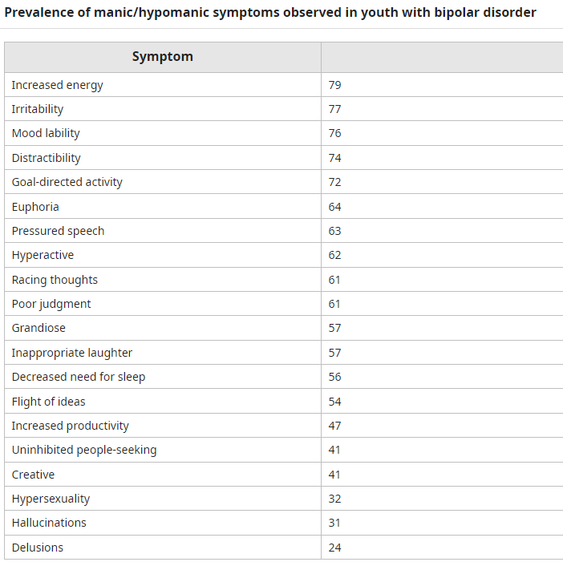
Adapted from: Van Meter AR, Burke C, Kowatch RA, et al. Ten-year updated meta-analysis of the clinical characteristics of pediatric mania and hypomania. Bipolar Disord 2016; 18:19;
UptoDate

Slide 10
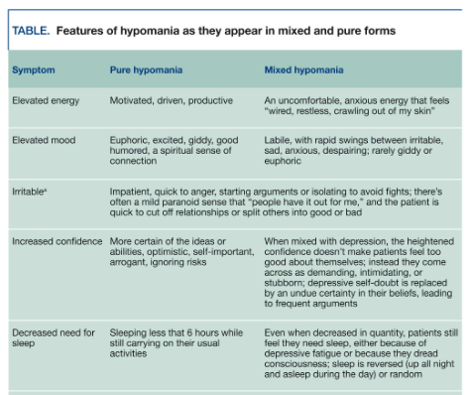
Aiken, 2018

Slide 11
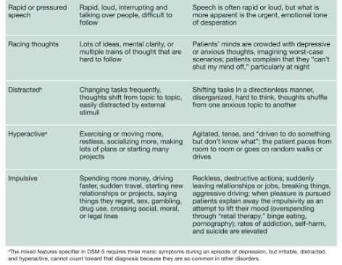
Aiken, 2018

Slide 12
The Bipolarity Index
Scores ≥50 have a high sensitivity (0.9) and specificity (0.9) for bipolar disorder
Scores in the 40-50 range suggest the patient is at risk of conversion to bipolar disorder and would benefit from careful monitoring

Slide 13
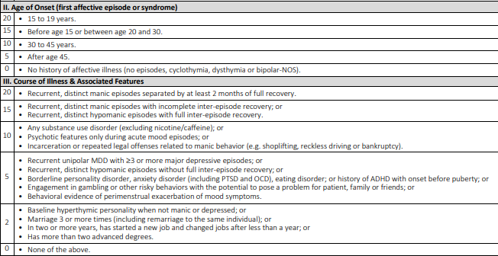
The bipolarity index

Slide 14
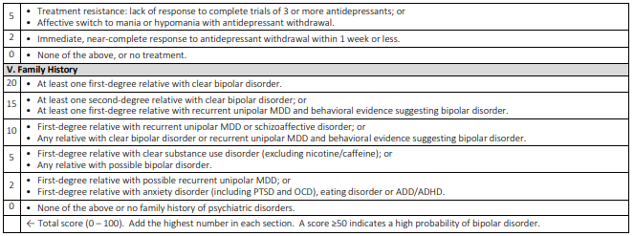
The bipolarity index

Slide 15
Cannabis and bipolar disorder
Relatively well-known association between marijuana and psychotic spectrum illnesses
Several articles have shown that marijuana may worsen manic symptoms in those with bipolar disorder
Cannabis may also be a causal risk factor, with an increased incidence of up to three-fold
Cannabis use and mania symptoms: a systematic review and meta-analysis, Gibbs, M, et al; J Affective Disord Jan 2015

Slide 16
Case 1
13 yo European-American female 8th grader, presenting with depression and anxiety, some risk-taking behaviors, including some sexting
Father with two sisters with bipolar disorder; after long discussion agreed to start SSRI and watch for emergence of mania
Patient engaged in therapy and psychiatry, parents setting appropriate limits
Anxiety and depression responded well to Lexapro
At 14 yo as patient started high school, ADHD, inattentive type became more apparent
Responded to low dose Vyvanse; doing well from anxiety and ADHD perspective
At 15 yo, after the onset of puberty, hypomanic episodes became more apparent
Responded and stabilized on lamotrigine; patient moved out of state at 16 yo

Slide 17
Case 2
12/2019: 14 yo European-American male c ADHD, referred for depression, difficulty leaving room at times
Mother wonders if he is antisocial or oppositional
Describes more verbal explosions, anhedonia, decreased moods, erratic sleep
Taking Adderall XR for ADHD; works well
Family history of autism (brother), anxiety, depression, ADHD
Pt denies anxiety or depression interfering with functioning; ‘doesn’t know’ why he doesn’t go to school
2/2020: Sudden shift after two months and pt returned to school-unclear why
12/2020: doing work online; wanting to try Vyvanse for ADHD
1/2021: doing poorly again, unknown reasons. Wondering about pt ability to describe internal state (neuroatypical)
3/2021: pt says he thinks he has bipolar disorder: periods of sleeping a lot, feeling sad, some normal weeks, some energized periods, talking more, doing things out of charaacter. Mother remembers her brother and grandfather had bipolar disorder
4/2021: rash ? on lamotrigine; tolerated. Continued titration
4-12/2021: benefit at first but backslide on 125 mg; did not improve up to 200 mg.
3/2022 switched to lithium. Depression contained by 4-5/2022. Reemergence of some mood symptoms (both mild depression and some hypomania) 2/23; increasing lithium slightly

Slide 18
References
Aiken, C. (2018). How to Diagnose Mixed Features without Overdiagnosing Bipolar. Psychiatric Times. 2018 Sep 6: Vol 35, Issue 9.
Aiken, CB, Weisler, RH, Sachs, GS. (2015). The Bipolarity index: a clinician-rated measure of diagnostic confidence. J Affect Disord. 2015 May 15;177:59-64. doi: 10.1016/j.jad.2015.02.004. Epub 2015 Feb 12
Asherson, P, Buitelaar, J, Faraone, SV, Rohde LA. (2016). Adult attention-deficit hyperactivity disorder: key conceptual issues. Lancet Psychiatry. 2016-06-01, Volume 3, Issue 6, Pages 568-578
Birmaher, B, Brent, D, Solomon, D. (2021). Pediatric bipolar disorder: Assessment and diagnosis. Pediatric bipolar disorder: Assessment and diagnosis – UpToDate, lit review updated February 2023.
Gibbs, M, Winsper, C, Marwaha, S, Gilbert, E, Broome, M, Singh, SP. (2015). Cannabis use and mania symptoms: a systematic review and meta-analysis. J Affect Disord. 2015 Jan 15;171:39-47. doi: 10.1016/j.jad.2014.09.016. Epub 2014 Sep 23.
Merikangas, KR, Jin, R, He, JP, Kessler, RC, Lee, S, et al. (2011). Prevalence and correlates of bipolar spectrum disorder in the world mental health survery initiative. Arch Gen Psychiatry. 2011 Mar;68(3):241-51.doi: 10.1001/archgenpsychiatry.2011.12.
Polanczyk G, de Lima MS, Horta BL, Biederman J, Rohde LA: The worldwide prevalence of ADHD: a systematic review and meta-regression analysis. Am J Psychiatry 2007; 164: pp. 942-948.
Schiweck, C, Arteaga-Henriquez, G, Aichholzer, M, Thanarajah, SE, Vargas-Cáceres, S, Matura, S, ... & Reif, A. (2021). Comorbidity of ADHD and adult bipolar disorder: A systematic review and meta-analysis. Neuroscience & Biobehavioral Reviews. https://doi.org/10.1016/j.neubiorev.2021.01.017
Singh, MK, Post, RM, Miklowitz, DJ, Birmaher, B, Youngstrom, E, Goldstein, B, Soutullo, C, Axelson, D, Chang, KD, DelBello, MP. (2021). A commentary on youth onset bipolar disorder. Bipolar Disorders. 2021 Dec;23(8):834-837.doi: 10.1111/bdi.13148. Epub 2021 Oct 29.

