Slide 1
Pediatric Sleep Disorders
Nick Natalizio, OMS-III

Slide 2
Objectives
Understand normal sleep in children and adolescence
Review common pediatric sleep disorders
Differentiate physiological vs. psychiatric disease processes
Discuss proper treatment options for childhood sleep disorders

Slide 3
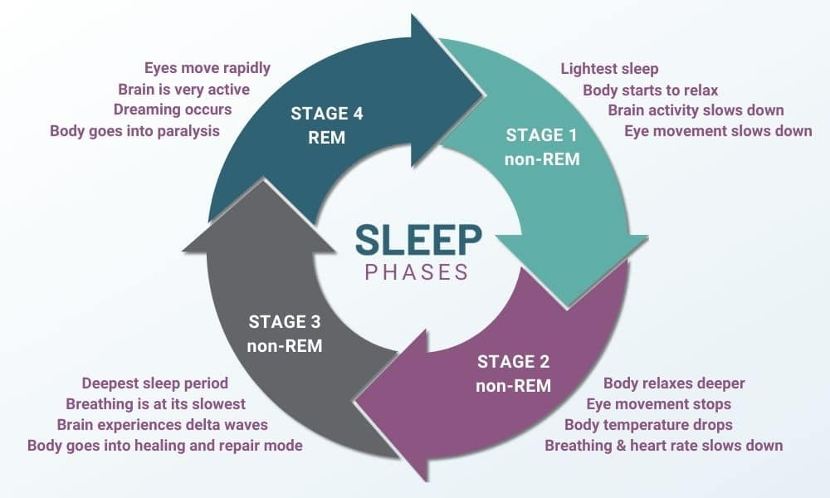
The Sleep Cycle
Notes:
“Let’s quickly review the sleep cycle”
One sleep cycle takes anywhere between 90-120 minutes
Could be things like
Confusional arousals
Sleep terrors
Sleepwalking
Exploding Head Disorder
Sleep related eating vs. nocturnal eating
Sexsomnia
REM sleep is particularly important bc it has a major impact on your memory, mental focus, and mood. plays a significant role in helping your brain consolidate and process new information. This information is then retained in your long-term memory

Slide 4
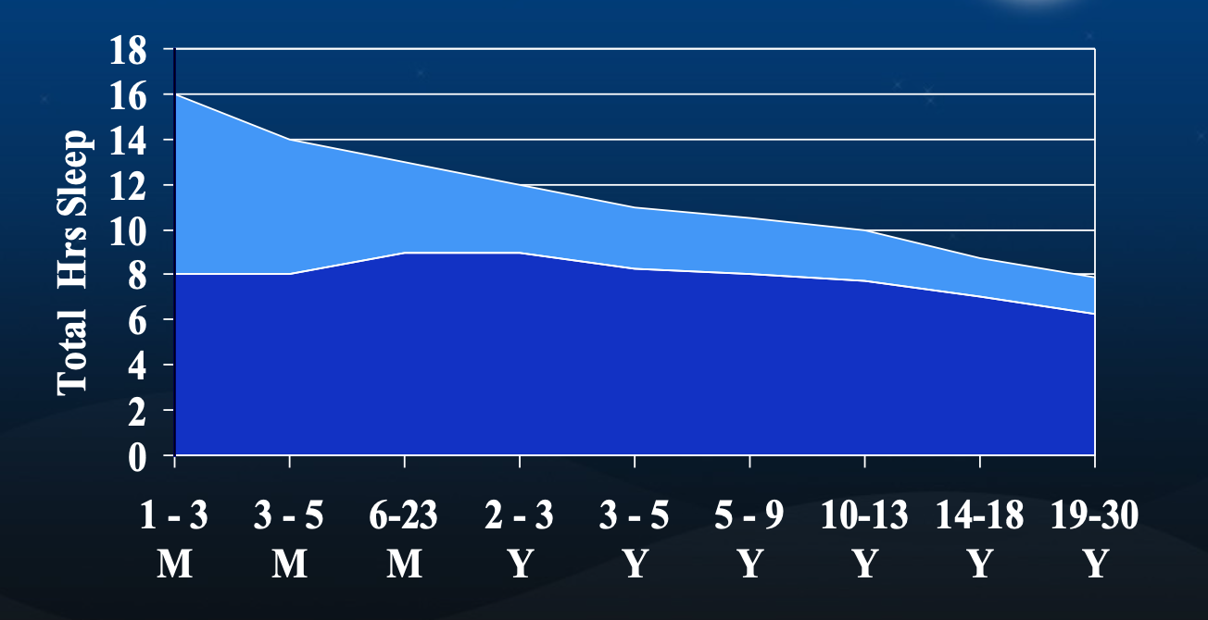
Total Daily Sleep by Age REM & NREM Sleep by Age
During childhood, sleep accounts for 40% of the day
At birth, REM is approx. 50% of sleep cycle
Decreases to approx. 25% in adulthood
Notes:
Light blue is REM Sleep
Dark blue NREM sleep
REM sleep decreases as we age
As you can see, children require much more REM sleep than adults.

Slide 5
Ramifications of Sleep Dysfunction
Psychological
Depression/mood lability
Irritability
Oppositionality
Anxiety
Fatigue/weakness
Neurocognitive
Deficits in attention, memory, learning
Hyperactivity/impulsivity (more common in younger children)
Deficits in executive functioning
Daytime sedation

Slide 6
DSM-V Sleep-wake Classifications
DSM-V classifies sleep-wake disorders into 10 groups:
Insomnia Disorder
Hypersomnolence Disorder
Narcolepsy
Breathing-related Sleep Disorders
Circadian Rhythm Sleep Disorder
Non-REM (NREM) sleep arousal disorders
REM sleep behavior disorder
Nightmare disorder
Restless leg syndrome
Substance- or medication-induced sleep disorder

Slide 7
Pediatric Sleep Disorders
Healthy sleeping habits for children are crucial to their physical and mental development
Sleep Disorders have been linked to a variety of psychiatric and non-psychiatric disease processes
Sleep disturbances can be the primary issue
Sleep disturbances can be a comorbid issue

Slide 8
Pediatric Sleep Disorders
Prevalence is approx. 20-25% of children in the U.S. experience a sleeping problem
An estimated 3.7% have an official ICD-9 diagnosis
Interferes with daily patient and family functioning
Sleep problems cause significant emotional, behavioral and cognitive dysfunction
Common amongst children with neurodevelopment, medical and psychiatric disorders
Notes:
This discrepancy suggests that primary care providers may be underdiagnosing pediatric sleep disorders

Slide 9
Grouping (based on ICD-9 codes) | Rates (%)
Bruxism | 0.004
Circadian Rhythm Disorder | 0.005
Hypersomnia | 0.004
Infant Apnea | 0.89 (0-12 mo)
Insomnia | 0.05
Narcolepsy | 0.003
Nocturnal Enuresis | 1.2 (>4 y)
Parasomnias | 0.05
Restless Leg Syndrome | 0.02
Sleep-Disordered Breathing | 1.04 (OSA and snoring)
Sleep Disorder Not Otherwise Specified | 1.4
z
Grouping (based on ICD-9 codes) | Rates (%)
ADHD | 4.2
Autism Spectrum Disorder | 0.9
Asthma | 14.5
Type 1 Diabetes | 0.21
Notes:
“An EMR review was conducted over the course of one year for all well-child visits among 32 urban and suburban pediatric practices affiliated with a large children’s hospital. Sample included 154,957 children and adolescents”
An electronic medical record review was conducted for all well-child care visits that occurred between January 1, 2007, and December 31, 2007, in 32 urban or suburban pediatric practices (with 175 physicians and 22 nurse practitioners) affiliated with a large, tertiary care, children’s hospital.
The sample included 154 957 children and adolescents (Table 1).
For children with >1 well-child care visit, only the most-recent visit was used.

Slide 10
Sleep Disturbances as a Psychiatric Disease Process
Sleep disturbances can be physiological, behavioral or a symptom of psychiatric conditions in children
Sleep disturbances can be a manifestation of numerous psychiatric disorders including:
MDD
GAD
PTSD
ADHD
Important to differentiate as treatment strategies differ
Notes:
Sleep disturbances can be a manifestation of numerous psychiatric disorders. Some of those include

Slide 11
Major Depressive Disorder and Sleep Disorders
75% of children with depression experience sleep disturbances
Over 50% experience insomnia
Insomnia is a risk factor for depression
4-5X increase among adolescents
Risk increases 8X with less than six hours of sleep per night
­Treat underlying condition in addition to relaxation techniques, positive reinforcement strategies, consistent bedtime schedules/routines
Notes:
- 30% experience severe insomnia
Insomnia alone is a risk factor for depression
It is also worth noting that overlseeping could also be a sign of depression. Some

Slide 12
Generalized Anxiety Disorders and Sleep Disorders
88% of pediatric patients with anxiety experienced at least one sleep-related problem
Over 50% had three or more sleep disturbances
Insomnia, nightmares, reluctance to sleep alone most common
42-66% of children with GAD experience insomnia
­Tx: underlying condition in addition to behavioral/environmental interventions
Notes:
Sleep onset may be delayed by close to an hour in anxious children
Sleep disturbances in early childhood are significant predictors of anxiety disorders 20 years later

Slide 13
PTSD and Sleep Disorders
Associated w/ specific parasomnias (e.g., nightmares, night terrors, enuresis)
Childhood sexual abuse associated with significant sleep disturbances 10 years after traumatic event
­Treatment should be focused on behavioral therapy (e.g., trauma-focused CBT) vs meds such as prazosin given limited studies

Slide 14
ADHD and Sleep Disorders
25-50% of children with ADHD experience sleep disorders
95% of patients with obstructive sleep apnea experience ADHD symptoms
Symptoms improve after successful treatment for OSA
­Other factors include disruptions in baseline circadian rhythm, sensory integration difficulties, stimulant rebound effects, comorbid psychiatric disorder (e.g., anxiety)
Notes:
­Sleep issues hypothesized to be combo of hypoarousal during day + compensatory hyperactivity to combat daytime hypoarousal and then inability to calm down at bedtime to fall asleep

Slide 15
Insomnia
When 3 of the criteria are met:
Complaint of
Difficulty initiating sleep
Difficulty maintaining sleep
Waking up too early
Sleep that is chronically non-restorative
Poor in quality
Occurs despite adequate opportunity for sleep
Produces deficits in daytime function
Causes of insomnia can be further divided into specific categories:
Adjustment Insomnia
Idiopathic Insomnia
Poor sleep Hygiene
Paradoxical Insomnia
Psychophysiological Insomnia
Notes:
Adjustment insomnia
Sleep disturbances due to an acute stressor
Momentous life event
Change in sleeping environment
Acute illness
Sleep improves with resolution of stressor or with adaptation
Idiopathic Insomnia
No identifiable etiology
Onset during infancy or early childhood
Chronic, life-long course
Inadequate sleep hygiene
Activities or behavior that increases arousal or decreases sleep propensity
TV
Clock watching
Late night snacks
Leptin
Released during sleep
Ghrelin
Paradoxical Insomnia
Sleep misperception
Subject reports minimal or no sleeping during most nights
Normal sleep quality and architecture during polysomnography
No daytime napping or impairment of daytime functioning
Psychophysiological insomnia
Associated with excessive worrying
Focused on not being able to sleep
Worried about being tired the next day (ruminate)
As a result, they become tense and anxious as bedtime approaches
May engage in bad behaviors to try to fall asleep
Sleeping pills, alcohol, spending too much time in bed hoping to fall asleep

Slide 16
Hypersomnolence
Self-reported excessive sleepiness despite a main sleep period lasting at least 7 hours, with at least one of the following symptoms:
Recurrent periods of sleep or lapses into sleep within the same day.
A prolonged main sleep episode of more than 9 hours per day that is nonrestorative (i.e., unrefreshing).
Difficulty being fully awake after abrupt awakening.
The hypersomnolence is accompanied by significant distress or impairment in cognitive, social, occupational, or other important areas of functioning.

Slide 17
Narcolepsy
Chronic sleep disorder caused by brain’s inability to regulate the sleep-wake cycle
It’s a neurological disorder characterized by clinical pentad of:
Excessive sleepiness
Cataplexy
Sleep paralysis
Sleep hallucinations
Fragmented nocturnal sleep
Only 10-15% of patients demonstrate this full pentad
Diagnosis
Clinical history
Narcolepsy with cataplexy can be diagnosed by history alone
PSG (polysomnography) followed by MSLT (mean sleep onset latency test)
Notes:
Sodium Oxybate Hypothesis
Narcolepsy is caused by the brain’s inability to regular sleep-wake cycle
Might be due to unwanted release of alerting neurotransmitters such as dopamine and norepinephrine at night resulting in frequent awakens
Sodium oxybate activates the GABA-B receptor which suppresses the release of dopamine and norepinephrine
In the morning there is a build-up and excess release of these neurotransmitters resulting in alertness during the day

Slide 18
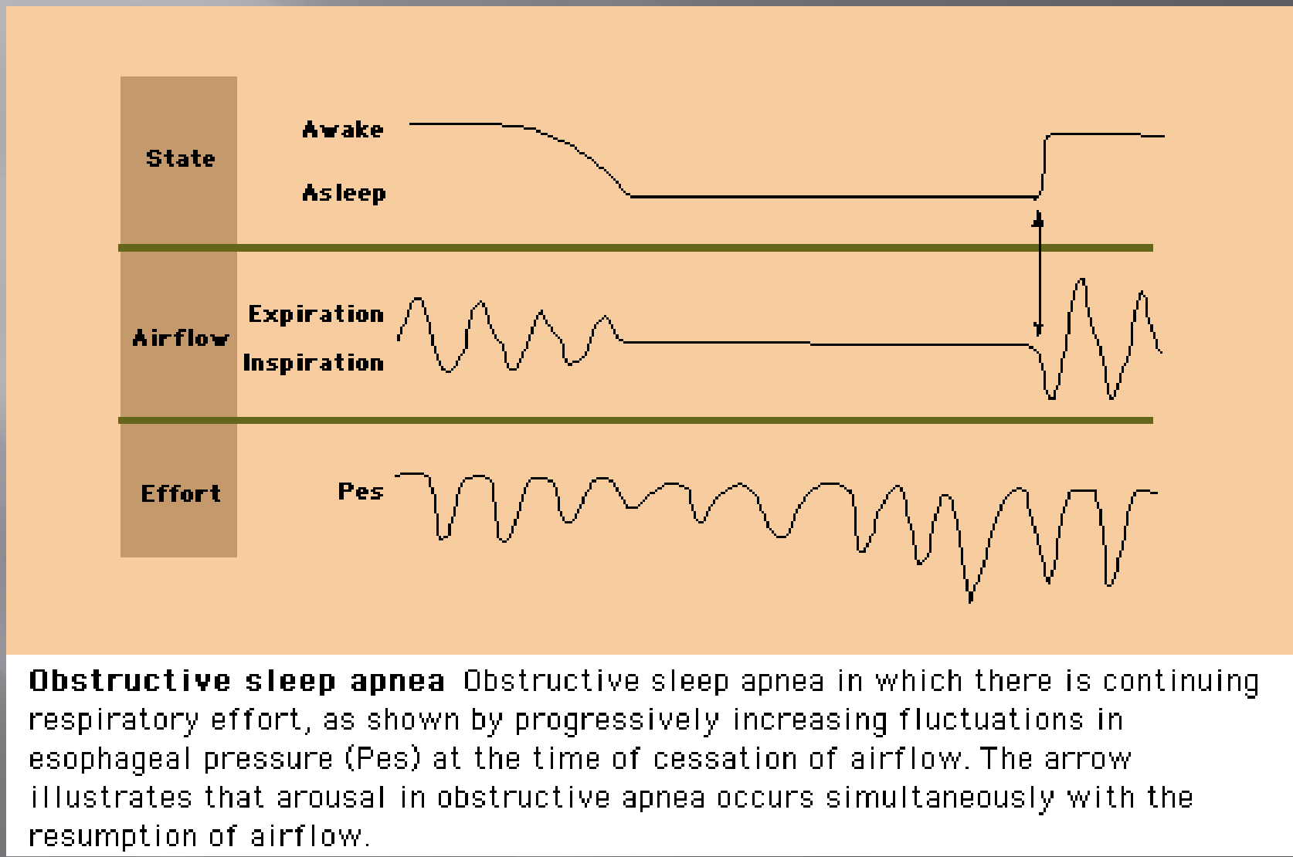
Breathing Related Sleep Disorders
Obstructive Sleep Apnea
Obstructive sleep apnea is defined as :
Cessation of airflow >90% in thermal sensor and 10 seconds duration, oxygen desaturation is NOT part of definition
Sleep apnea occurring despite continued ventilatory effort
Frequently associated with:
Abnormal Airway
Neck circumference
Tonsillar hypertrophy or lymphoma
Micrognathia
Acromegaly
Goiter
Temporomandibular joint disease (TMJ)
Obesity
Not a necessary feature

Slide 19
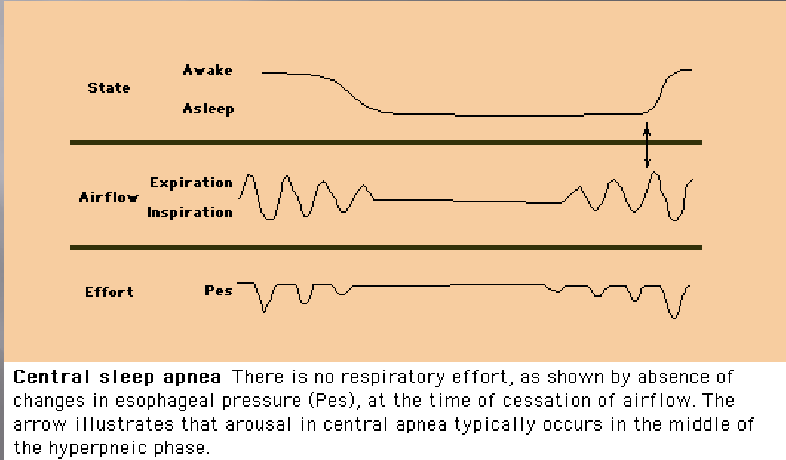
Breathing Related Sleep Disorders
Central Sleep Apnea
Hypercapnic CSA
High sleep and waking PaCO2
Decreased ventilation response to hypercapnia
Cause:
Neuromuscular disorders
Chronic use of long-acting opioids
Non-Hypercapnic CSA
Normal or low waking PaCO2
Increased ventilator response to hypercapnia
Causes
Primary or idiopathic CSA
Sleep-onset CSA
Cheyne strokes respiration
High altitude periodic breathing
Complex sleep apnea
Notes:
Characterized by high sleep and waking PaCO2
Decreased ventilation response to hypercapnia
Causes:
Neuromuscular disorders
Amyotrophic lateral sclerosis, myasthenia gravis, Guillain-Barre syndrome, muscular dystrophy
Chronic use of long-acting opioids
Biot’s respiration

Slide 20
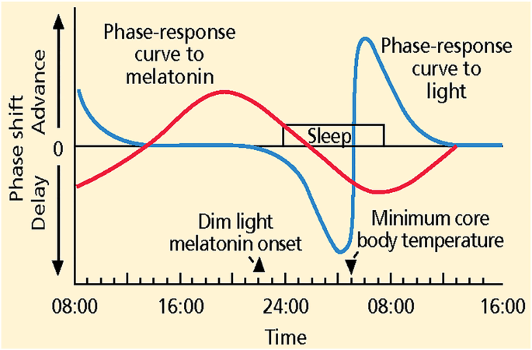
Circadian Rhythm Sleep Disorders
Family of sleep disorders affecting the timing of sleep
Patients unable to sleep and wake at the times required for normal work, school, or social needs
Able to get enough sleep if able to wake at the times dictated by their body clocks
Extrinsic type
Jet Lag
Shift work
Intrinsic type
Advance sleep phase disorder
Delayed sleep phase disorder
Free-running circadian disorder
Irregular sleep-wake rhythm
Notes:
Extrinsic type
Jet Lag
Easier to travel west
Shift work
Affects people who work nights or rotating shifts
Intrinsic type
Advance sleep phase disorder
Morning lark
Delayed sleep phase disorder
Night owl
Free-running circadian disorder
Blind
Irregular sleep-wake rhythm
Alzheimer’s dementia

Slide 21
Non-REM Sleep Arousal Disorders
NREM Sleep Arousal Disorders are a type of Parasomnia. A category of sleep disorders that involve abnormal and unnatural movements, behaviors, emotions, perceptions, or dreams
Parasomnias during non-REM sleep include:
Confusional arousals
Sleep terrors
Sleepwalking
Exploding Head Disorder
Sleep related eating vs. nocturnal eating
Sexsomnia
Notes:
Parasomnias during NREM sleep
Confusional arousals
Act in a strange and confused way as you wake up or just after waking
Slow speech
Confused thinking
Poor memory
Blunt responses to questions or requests
Tend to occur as you wake from slow-wave sleep
Sleep terrors
Patient remains asleep as opposed to nightmares which can wake the patient up . Usually not memory of it with sleep terrors
Sleepwalking
Precipitating factors include
Sleep deprivation (most important)
Zolpidem
OSA (improves with treatment)
Alcohol consumption
Little or no memory of the incident
Patient’s eyes are usually open
Activities can be as benign as
Sitting up in bed
Walking to the bathroom
Cleaning
Hazardous as cooking or driving
Exploding head syndrome
Sleep related eating vs. nocturnal eating

Slide 22
REM Sleep Behavior Disorder
Abnormal “dream-enacting” behavior during REM sleep
Loss of REM-related muscle atonia
More common in older male adults (>50 years old)
Can result in injuries to patient or bed partner
Associated with the development of Parkinson’s and Lewy Body Dementia
Notes:
Medical Therapy
Clonazepam
Works by suppressing phasic REM
Melatonin
Restores tonic REM

Slide 23
Nightmare Disorder
Recurrent episodes of extended, extremely dysphoric, and well-remembered dreams that usually involve efforts to avoid threats to survival or security or physical integrity. The nightmares generally occur in the second half of a major sleep episode.
On waking from the nightmare, the individual rapidly becomes oriented and alert.
The episodes cause significant distress or impairment in social, occupational or other areas of functioning.
Notes:
The symptoms cannot be explained by the effects of a drug of abuse or medication.
The nightmares cannot be attributed to another mental disorder (i.e., posttraumatic stress disorder, delirium) or medical condition.
Nightmares are frightening events for a child and may be concerning for the family; however, they are transient and developmentally normal for most children

Slide 24
Substance or Medication Induced Sleep Disorder
Sleep disturbances with substance intoxication and/or withdrawal: alcohol, caffeine, cannabis, opioids, sedatives (hypnotics or anxiolytics), tobacco, stimulants (such as cocaine or amphetamines), and other substances.
Certain medications such as adrenergic agonists/antagonists, dopamine agonists/antagonists, cholinergic agonists/antagonists, serotonergic agonists/antagonists, antihistamines, and corticosteroids can also cause sleep disturbances.
Notes:
Antidepressants (serotonergic agonist/antagonist)
Fluoxetine (most common side effect – 33%)
Protriptyline (Vivactil)
Beta-blockers (adrenergic antagonist)
Block melatonin
Bronchodilators
Decongestants
Pseudoephedrine
Steroids
Stimulants
Caffeine, nicotine, amphetamines, ecstasy, energy drinks

Slide 25
Sources
American Physician Institue – Master Psych
Chorney DB et al. Journal of Pediatric Psychology, 2008;33(4):339–348
O’Brien, Louise M. The neurocognitive effects of sleep disruption in children and adolescents. Child and Adolescent Clinics of North America. 2009 Oct; 18(4): 813-823
Ohayon MM, Roth T. What are the contributing factors for insomnia in the general population? J Psychosom Res. 2001 Dec;51(6):745-55. doi: 10.1016/s0022-3999(01)00285-9. PMID: 11750297.
Owens JA, Mindell JA. Pediatr Clin North Am. 2011;58:555-69. Sivertsen B et al. Eur Child Adolesc Psychiatry. 2014;23:681-9.
Sadeh A. Sleep Disorders, 1996, vol. 5 (685-700) Chorney DB et al. Journal of Pediatric Psychology, 2008;33(4):339–348
Substance Abuse and Mental Health Services Administration. Impact of the DSM-IV to DSM-5 Changes on the National Survey on Drug Use and Health [Internet]. Rockville (MD): Substance Abuse and Mental Health Services Administration (US); 2016 Jun. Table 3.35, DSM-IV to DSM-5 Hypersomnolence Disorder Comparison. Available from: https://www.ncbi.nlm.nih.gov/books/NBK519704/table/ch3.t35/

