Slide 1
Attention- Deficit/Hyperactivity Disorder
Emily Atkinson, OMS-III
Desiree King, OMS-iii

Slide 2
What is ADHD?
Neurodevelopmental disorder that causes functional impairment
Social, academic, cognitive, behavioral, emotional impairments
Diagnostic criteria via the DSM-V
Inattentive Type
Hyperactive-Impulsive Type
Combined Type
Multifactorial- combination of genetic and environmental factors
Family history of ADHD
Premature birth
Exposure to EtOH in-utero
Notes:
Multifactorial, but ultimately results from altered catecholamine metabolism
Genetic Factors:
Family history of ADHD
Environmental Factors:
Premature birth
< 32 weeks more commonly show inattentive type ADHD
Exposure to EtOH in-utero

Slide 3
Worldwide prevalence of adhd
Per American Journal of Psychiatry (2007)
ADHD/HD worldwide-pooled prevalence: 5.29%
Geographic location was associated with significant variability between North America Africa, and the Middle East (the latter having much lower prevalence)
No significant differences were found in prevalence rates between North America, Europe, South America, Asia, or Oceania.

Slide 4
US Prevalence of adhd
Per Journal of Clinical Child and Adolescent Psychology (2016)
Prevalence of ADHD among US children b/w ages 2-17 : 8.4%
Percent of children who have ever had a diagnosis of ADHD based on parent report alone: 9.4%
1% difference could potentially be due to parent-report bias (i.e. previously age-appropriate behavior now being reported as pathological)
Notes:
https://jamanetwork.com/journals/jamanetworkopen/fullarticle/2810136?resultClick=1

Slide 5
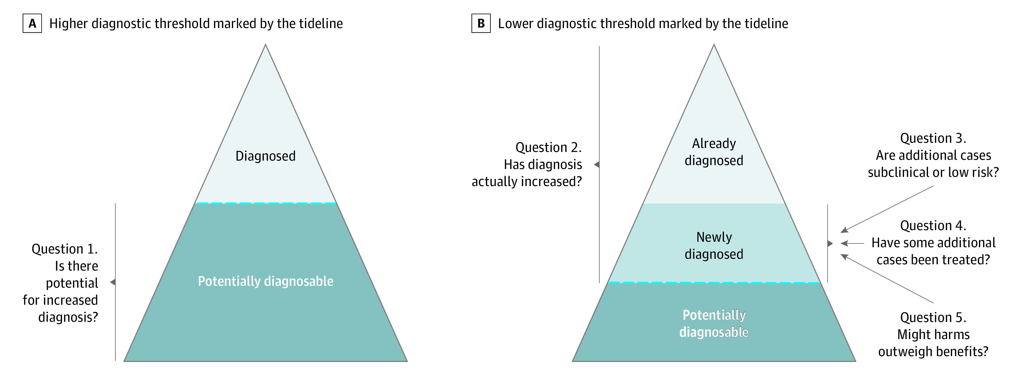
Are we over-diagnosing?
An article published by JAMA in 2021 used a 5-question framework model to assess the potential for overdiagnosis of ADHD
Notes:
https://www.ncbi.nlm.nih.gov/pmc/articles/PMC8042533/#note-ZOI210181-1-s

Slide 6
Main outcomes
Q1: Large variations in ADHD diagnosis were found between subpopulations in 48 studies
Q2: 30 studies estimated change in diagnostic prevalence of ADHD over time, with 27 documenting increased trends
Q3: Eight studies confirmed that impairment levels, adverse outcomes, and benefits of medication substantially decreased with the addition of milder cases
Q4: Q. 4: 64 of these studies showed increased percentage of youths being treated pharmacologically
Notes:
https://www.ncbi.nlm.nih.gov/pmc/articles/PMC8042533/#note-ZOI210181-1-s
https://www.ncbi.nlm.nih.gov/pmc/articles/PMC8042533/#note-ZOI210181-1-s

Slide 7
Main outcomes (cont.)
Q5a: Regarding the general benefits of a diagnosis, 2 main themes emerged
Dx created a sense of empowerment
Enablement was experienced (characterized by increased support and enhanced ability to seek/accept help)
Q5a: Regarding the general harms of a diagnosis, 2 themes also emerged
In 22 studies, a biomedical view of difficulties was associated with disempowerment
14 studies reported on stigmatization
Q5b: Relatively large symptom reductions via medication translate to modest decreases in functional impairment at best
This ratio is likely worse for youth with milder ADHD

Slide 8
Conclusions
There is convincing evidence of ADHD overdiagnosis and overtreatment in children and adolescents
Larger studies need to be conducted to confirm whether the additional ADHD cases now being diagnosed have milder symptoms.
An option to improve the balance of benefit to harm in practice may be to follow a stepped-diagnosis approach
incorporates the valid need for efficient diagnosis and treatment for severe cases
Emphasizes a watch-and-wait approach for borderline cases.
echoes management by active surveillance of low-risk prostate, breast, and thyroid cancers, in which overdiagnosis occurs frequently

Slide 9
Commonly used medications
Stimulants (amphetamines, methylphenidate)*
Alpha2 agonists (guanfacine*, clonidine)
SNRIs (atomoxetine*, viloxazine*)
Antidepressants (bupropion, SSRIs, TCAs)
Atypical antipsychotics (olanzapine, risperidone)
*FDA approved for tx of ADHD

Slide 10
Current Tx/efficacy
Lancet Psychiatry (2018)
Considering both efficacy and safety, evidence from this meta-analysis supports
methylphenidate in children and adolescents
amphetamines in adults
as preferred first-choice medications for the treatment of ADHD

Slide 11
Current Tx/efficacy
PubMed (2017)
Behavioral therapy + stimulants > stimulants/ non-stimulants alone
Stimulants > non-stimulants + behavioral therapy, cognitive training
Behavioral therapy, stimulants and their combination showed the best profile of acceptability
Methylphenidate/amphetamine > atomoxetine and guanfacine.
Methylphenidate/clonidine seemed better accepted than placebo and atomoxetine.

Slide 12
Current Tx/Efficacy
Most of the effective meds were associated with harms (anorexia, weight loss and insomnia)
increased risk of serious adverse events was not observed
There is lack of evidence for cognitive training, neurofeedback, antidepressants, antipsychotics, dietary therapy, fatty acids, and other complementary and alternative medicine

Slide 13
Conclusions
Clinical differences may exist between the pharmacological and non-pharmacological treatment used for the management of ADHD
There is an urgent need for high-quality randomized trials of the multiple treatments for ADHD in children and adolescents
New research should be funded urgently to assess long-term effects of these treatments.
Notes:
Re-read the conclusions and verify findings****
Polypharmacy?
Can delete this slide...

Slide 14
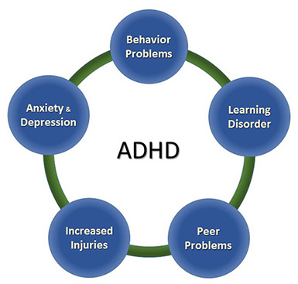
...not just ADHD
Notes:
Image References:
https://www.cdc.gov/ncbddd/adhd/data.html#another
https://www.cdc.gov/ncbddd/adhd/conditions.html
Risk of Injuries
Children and adolescents with ADHD are likely to get hurt more often and more severely than peers without ADHD. Research indicates that children with ADHD are significantly more likely to
Get injured while walking or riding a bicycle
Have head injuries
Injure more than one part of their body
Be hospitalized for unintentional poisoning
Be admitted to intensive care units or have an injury resulting in disability
More research is needed to understand why children with ADHD get injured, but it is likely that being inattentive and impulsive puts children at risk. For example, a young child with ADHD may not look for oncoming traffic while riding a bicycle or crossing the street, or may do something dangerous without thinking of the possible consequences. Teenagers with ADHD who drive may take unnecessary risks, may forget rules, or may not pay attention to traffic.
Health Risks
The core symptoms of ADHD, like impulsivity and inattention, might lead children to behave in ways that can put their health at risk or cause them to forget healthy and protective behaviors. Over time, if not addressed, these risks can lead to injury, disease, or even an earlier-than-expected death. In addition to injuries, children with ADHD are at increased risk for being overweight or having obesity. Healthy habits for children include:
Developing healthy eating habits, such as eating plenty of fruits, vegetables, and whole grains, and choosing lean protein sources.
Participating in daily physical activity based on age.
Limiting the amount of daily screen time from TVs, computers, phones, and other electronics.
Getting the recommended amount of sleep each night based on age.
Learn more about protecting the health of children with ADHD

Slide 15
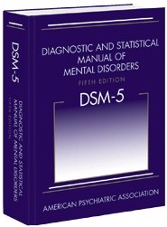
Shared Symptomology:
Developmental Disorders or Psychological Disorders
Autism Spectrum Disorder
Specific Learning Disorder
Intellectual Disability
Developmental delays:
Speech and language
Delayed milestones..
Reactive Attachment Disorder
Oppositional Defiant Disorder
Conduct Disorder
PTSD
Bipolar Dx
Other Medical Considerations:
Seizure Disorders, such as Absence Seizures
Thyroid Disorders
Sleep Disorders & sleep deprivation
Hearing or Vision Impairments
Genetic Disorders
Medication Side Effects
This Photo by Unknown author is licensed under CC BY-SA.

Slide 16
ADHD New developments
This Photo by Unknown author is licensed under CC BY.

Slide 17
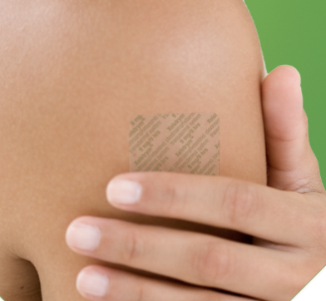
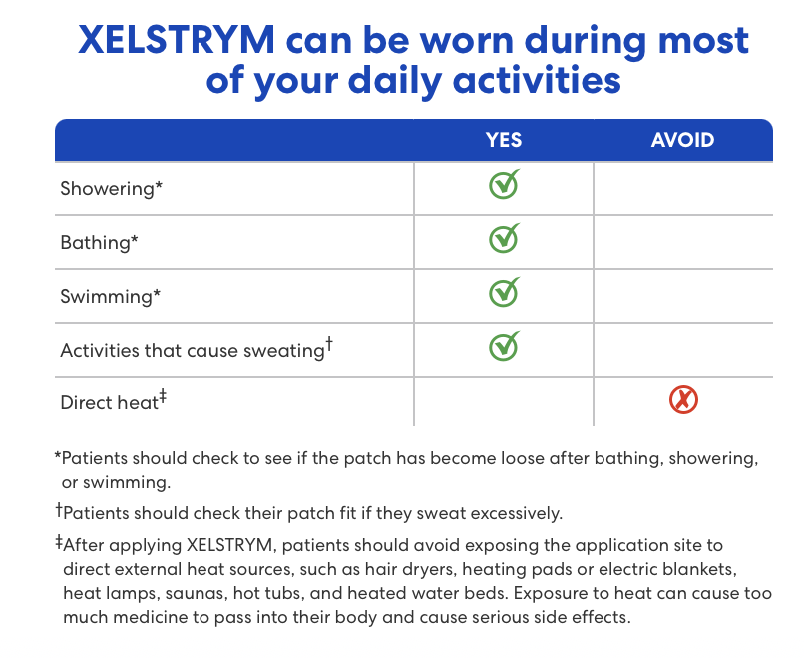
Xelstrym Noven PharmeceuTicals
FDA approved in 2022 for adults & in 2023 for children ages 6+ for the treatment of ADHD
Dextroamphetamine transdermal patch
Strengths: 4.5mg, 9mg, 13.5mg, and 18mg
Dosing: Once daily, 2 hours prior to needed effect, removed after 9 hours
Black Box Warning:
Abuse, Misuse, and Addiction
Notes:
https://dailymed.nlm.nih.gov/dailymed/drugInfo.cfm?setid=0862f02a-72a8-41cc-8845-57cf4974bb6f
https://www.xelstrymhcp.com/adhd-medication-efficacy-side-effects

Slide 18
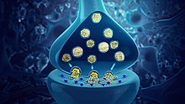
Centanafadine Otsuka Pharmaceuticals
Triple Reuptake Inhibitor: SNDRI
Affinity for receptors in descending order: NE > Dopamine > Serotonin
Indication: Adult ADHD, child ADHD, MDD
Phase III Trials for ages 6-12 and 13-17
6-week double blind randomized trial in Canada and the US
3 arms- low dose, high dose, placebo
October 2023- preliminary results
Full study results being submitted for publication at a later date
Clinical pharmacology and long-term stability studies currently underway
NDA to be filed in the US once studies completed
This Photo by Unknown author is licensed under CC BY-SA.
Notes:
https://www.otsuka-us.com/news/otsuka-pharmaceutical-announces-positive-topline-results-two-pivotal-phase-3-trials
"Full study results are not yet available. The trial results are planned to be submitted for scientific publication at a later date. Clinical pharmacology studies and long-term stability studies are underway, and the NDA will be filed in the U.S. as soon as these are completed.
Otsuka is incredibly appreciative to all the children and adolescents with ADHD, their families and caregivers, as well as the investigators and site staff who participated in the trial(s) and contributed greatly to this research."
https://www.psychiatrictimes.com/view/mixed-bag-phase-3-data-for-adhd-treatment-presented-at-ashp-meeting
“Centanafadine showed a better safety/tolerability profile than lisdexamfetamine, atomoxetine, and viloxazine ER, as evidenced by a significantly lower incidence of several adverse side effects,” the researchers noted. “Efficacy was lower than lisdexamfetamine and non-different compared to atomoxetine and viloxazine ER.”

Slide 19
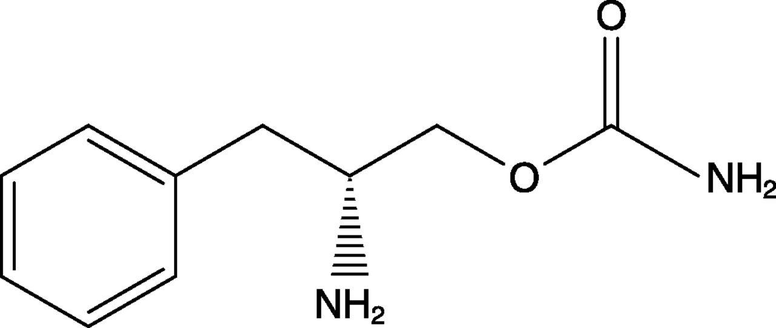
Solriamfetol Axsome Therapeutics
DNRI
FDA approved for Adults with EDS associated with Narcolepsy and OSA
Much more potent binding to dopamine and NE receptors
Higher affinity and activity at the dopamine transporter
August 2021- January 2023: Pilot study for ADHD
Small clinical trial at MGH adults (60 adults)
No significant effect on sleep quality, average HR, or BP
Need larger studies
July 2023: FOCUS (Forward Treatment of ADHD Using Solriamfetol)
Phase 3, randomized, double blind, placebo controlled multicenter trial
This Photo by Unknown author is licensed under CC BY.
Notes:
https://www.massgeneral.org/news/press-release/clinical-trial-demonstrates-benefits-of-solriamfetol-for-adults-with-adhd
https://pubmed.ncbi.nlm.nih.gov/37819836/
Also being studied for addiction, MDD, excessive sleep in Parkinson's, binge eating disorder
Phenylalanine derivative
https://www.pharmaceutical-technology.com/data-insights/solriamfetol-hydrochloride-axsome-therapeutics-attention-deficit-hyperactivity-disorder-adhd-likelihood-of-approval-2/?cf-view
https://clinicaltrials.gov/study/NCT04839562?term=NCT04839562&rank=1

Slide 20
CTx-1301 Phase III Clinical Trial Cingulate Pharmaceuticals
Dexmethylphenidate
Innovative Precision Timed Release (PTR) drug delivery platform
Novel formulation
Trimodal Extended Release
3 timed releases to increase Dopamine and NE
Mastery Clinical Program
July 2023- adults
Currently- Phase III pediatric and adolescent studies
Notes:
https://www.cingulate.com/news-releases/news-release-details/cingulate-announces-positive-top-line-results-phase-3-adult
https://www.biospace.com/article/releases/cingulate-announces-detailed-trial-results-from-phase-3-adult-efficacy-and-safety-trial-of-ctx-1301-dexmethylphenidate-for-adhd/

Slide 21
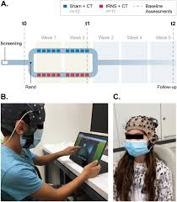
Transcranial Random Noise Stimulation
High frequent transcranial random noise stimulation applied with cognitive training
Randomized, double-blind, sham-controlled trial
23 unmedicated children with ADHD
Improved clinical ADHD symptoms immediately following treatment and did not significantly change at the 3 week follow up
Notes:
Transcranial Stimulation
https://www.healthday.com/health-news/child-health/adhd-2662667533.html
https://www.nature.com/articles/s41398-023-02547-7

Slide 22
Other Non-Pharmacologic Treatments
"Squirm to Learn"
Exercise- "Off the Couch"
Rewards as big motivators
This Photo by Unknown author is licensed under CC BY.
Notes:
Squirm to learn
https://www.understood.org/en/articles/news-study-suggests-squirming-may-help-some-kids-with-adhd-learn
https://link.springer.com/article/10.1007/s10802-015-0011-1
Exercise
https://www.webmd.com/add-adhd/childhood-adhd/exercise-for-children-with-adhd_
Rewards
https://embracingyoutherapy.com/how-the-reward-system-in-adhd-affects-motivation/
https://justmind.org/motivation-and-rewards-for-kids-with-and-without-adhd/

Slide 23
References:
Danielson ML, Bitsko RH, Ghandour RM, Holbrook JR, Kogan MD, Blumberg SJ. Prevalence of Parent-Reported ADHD Diagnosis and Treatment Among U.S. Children and Adolescents, 2016. Journal of Child and Adolescent Psychology. 2018; 47(2), 199-212
Centers for Disease Control and Prevention. Attention-Deficit/Hyperactivity Disorder (ADHD). https://www.cdc.gov/ncbddd/adhd/data.html#another and https://www.cdc.gov/ncbddd/adhd/conditions.html
Xelstrym, Noven Pharmaceuticals. https://www.xelstrymhcp.com/adhd-medication-efficacy-side-effects
Otsuka Press Release- https://www.otsuka-us.com/news/otsuka-pharmaceutical-announces-positive-topline-results-two-pivotal-phase-3-trials
Psychiatric Times. Article: Mixed Bag Phase 3 Data for ADHD Treatment Presented at ASHP Meeting. Author: Lauren Biscaldi. June 12, 2023. Referenced from Schein J. Assessment of centanafadine in adults with ADHD: A matching adjusted indirect comparison vs lisdexamfetamine dimesylate, atomoxetine, and viloxazine ER. Presented at: American Society of Health-System Pharmacists Summer Meetings and Exhibition; June 10-14, 2023; Baltimore, MD.
Clinical trial demonstrates benefits of solriamfetol for adults with ADHD. Author: Leslie Perez. Massachusetts General Hospital, Press Release, October 10, 2023.
Surman CBH, Walsh DM, Horick N, DiSalvo M, Vater CH, Kaufman D. Solriamfetol for Attention-Deficit/Hyperactivity Disorder in Adults: A Double-Blind Placebo-Controlled Pilot Study. J Clin Psychiatry. 2023 Oct 9;84(6):23m14934. doi: 10.4088/JCP.23m14934. PMID: 37819836.
A study to Access the Efficacy and Safety of Solriamfetol in Subjects with ADHD (FOCUS) ClinicalTrials.gov identifier: NCT05972044. https://classic.clinicaltrials.gov/ct2/show/NCT05972044
Cingulate, Press Release. Cingulate Announces Positive Top-Line Results from Phase 3 Adult Efficacy and Safety Trial of CTx-1301 Dexmethylphenidate for ADHD. https://www.cingulate.com/news-releases/news-release-details/cingulate-announces-positive-top-line-results-phase-3-adult
Dakwar-Kawar, O., Mairon, N., Hochman, S. et al. Transcranial random noise stimulation combined with cognitive training for treating ADHD: a randomized, sham-controlled clinical trial. Transl Psychiatry 13, 271 (2023). https://doi.org/10.1038/s41398-023-02547-7
https://ajp.psychiatryonline.org/doi/10.1176/ajp.2007.164.6.942?url_ver=Z39.88-2003&rfr_id=ori:rid:crossref.org&rfr_dat=cr_pub%20%200pubmed
https://acamh.onlinelibrary.wiley.com/doi/10.1111/jcpp.12381
https://pubmed-ncbi-nlm-nih-gov.une.idm.oclc.org/30097390/
https://pubmed-ncbi-nlm-nih-gov.une.idm.oclc.org/28700715/

