Slide 1
Suicide Assessment:
What to do after a Positive Screen
Kasey Moss DO MPH
Regional Medical Director
Maine Behavioral Healthcare Brunswick/Damariscotta

Slide 2
Disclosures
No financial disclosures
Activating content!

Slide 3
Objectives
Systematic approaches to interpret screening and assessment results to connect youth to appropriate care and treatment.
Best practices for treatment and application of care plans.
Clinical strategies and partnership opportunities that pediatric health clinicians can use to better support youth at risk for suicide.

Slide 4

Limitations of this presentation
Notes:
Trying to fit years of training/experience into a 15 minute presentation

Slide 5

Positive Screen
Notes:
Before we discuss positive screen lets discuss screening tools

Slide 6


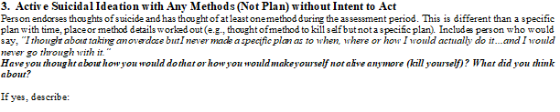
C-SRRS Very Young Child

Slide 7
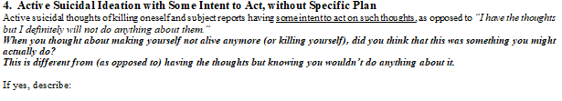
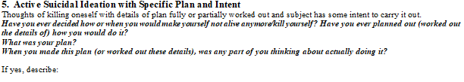
C-SRRS Very Young Child

Slide 8
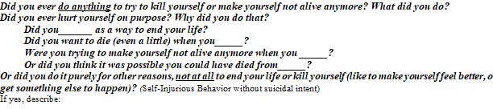
Actual/interrupted/aborted attempt

Slide 9
Actual/perceived lethality
Patient takes 3 ibuprofen and 2 acetaminophen
Patient cuts wrist to the point of needing sutures

Slide 10
Likelihood of rescue
Takes ingestion late at night while parents are sleeping and goes to bed
Immediately calls mom after cutting

Slide 11
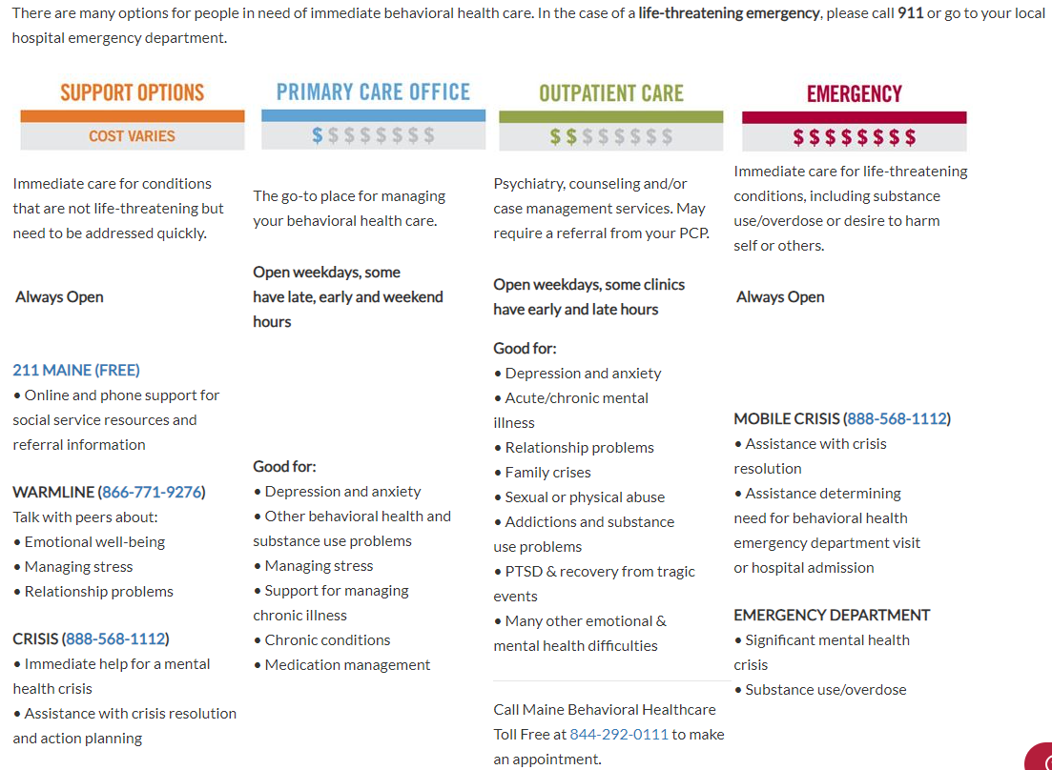

Slide 12
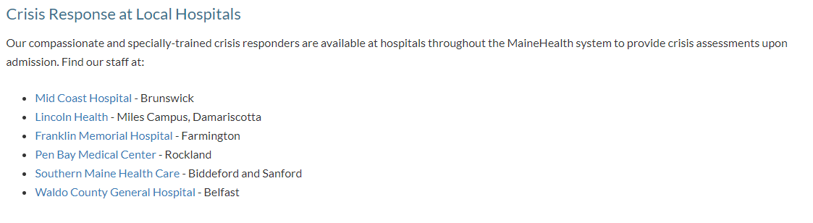
MBH Crisis

Slide 13
Outside of MBH
All counties in Maine have access to crisis services
Purpose: Crisis Services provides immediate response in person or over the phone to all Maine children, youth, and families who are experiencing a mental health in crisis, in order to keep everyone safe. Crisis services can provide up to 6 visits to the family after the initial crisis is over.
Population Served: Any Maine child or youth who is experiencing a mental health crisis, including dangerous behaviors or thinking.
How to Access: Contact the Maine Crisis Line at 1-888-568-1112 to access this service, available 24-hours a day, 7-days a week.
Information Sheet: Information sheets are a helpful tool to ensure youth and parents/guardians are fully informed about behavioral health services. Prior to referring a family for a particular children’s behavioral health service, please review the information sheet with the youth and family to ensure they are interested in the service.
Emergency Department Data Reporting: The Youth in ED Data Reporting Tool is a downloadable, Excel form, that can be saved to the user’s computer and should utilize a unique identifier for each youth entered. The completed form should be emailed to CBHS.EDData@maine.gov by the 15th of each calendar month.
Should you have any questions please feel free to reach out to Ellie Larrabee at ellie.larrabee@maine.gov

Slide 14
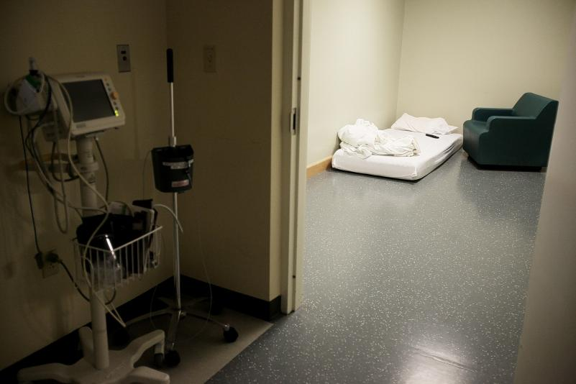
What are the other costs to high levels of care ?

Slide 15
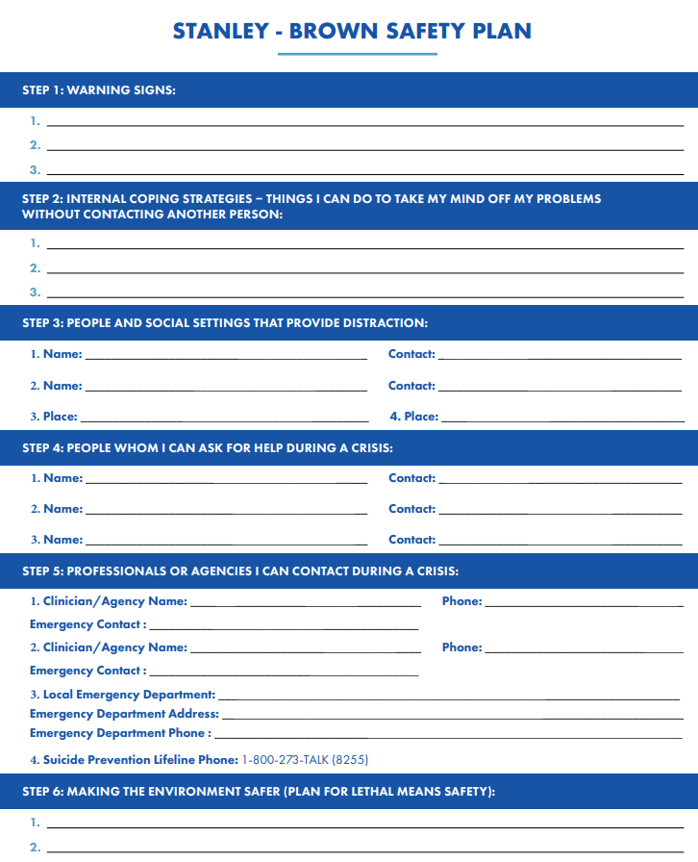

Slide 16
Lethal Means Restriction
Lethal Means Counseling | Means Matter | Harvard T.H. Chan School of Public Health

Slide 17
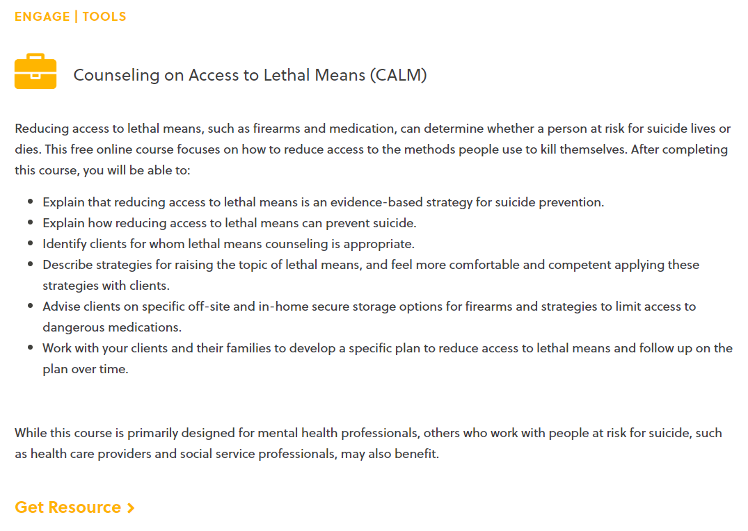

Slide 18
References
https://www.mainehealth.org/Services/Behavioral-Mental-Health/Crisis-Services
https://cssrs.columbia.edu/documents/c-ssrs-full-lifetime-recent-scale-young-children-4-5/
https://bgg.11b.myftpupload.com/wp-content/uploads/2021/08/Stanley-Brown-Safety-Plan-8-6-21.pdf
https://www.hsph.harvard.edu/means-matter/lethal-means-counseling/
https://zerosuicide.edc.org/resources/resource-database/counseling-access-lethal-means-calm
Children’s Behavioral Health Programs and Services | Department of Health and Human Services (maine.gov)

