Slide 1
Navigating the Brain-Gut Axis
Noah Hoffman, MD, MSHP
October 23, 2025

Slide 2
Disclosures
I have no financial relationships to disclose.

Slide 3
Objectives
Discuss the overlap of behavioral health disorders and disorders of gut-brain interaction (DGBI).
Learn to convey diagnostic confidence in DGBI and set the stage for therapeutic recommendations.
Prepare to implement pharmacologic and non-pharmacologic therapies for DGBI in the medical home (or outside the pediatric GI clinic).

Slide 4
Definition
Disorders of Gut-Brain Interaction (DGBI) are characterized by gastrointestinal (GI) symptoms related to abnormalities in
motility
visceral sensitivity
intestinal permeability
immune activation
neuroendocrine function
central nervous system processing
the gut microbiota
Examples include:
Irritable Bowel Syndrome (IBS)
Functional Dyspepsia
Recurrent Abdominal Pain
Abdominal migraine
Others…
Gastroenterology 2022 163(4): 995-1023

Slide 5
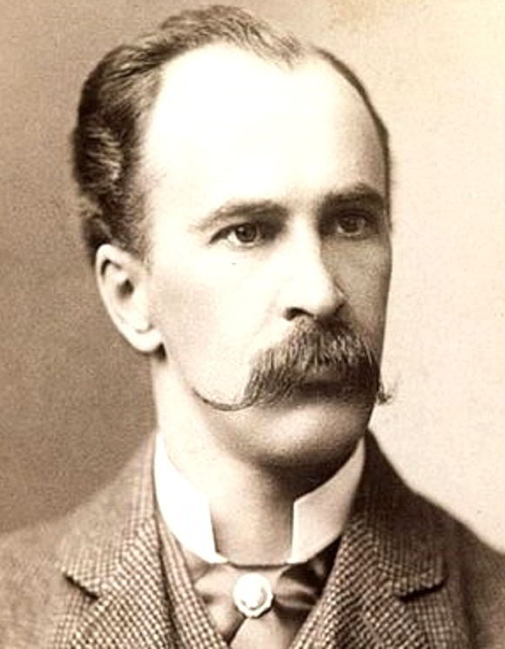
Inspiration
“It is much more important to know what sort of a patient has a disease than what sort of a disease a patient has.”

Slide 6
Epidemiology
Approximately 25% of children meet Rome IV criteria for a disorder of gut-brain interaction.
Infant Regurgitation
Functional Constipation
… others
Diminished QoL
(children AND families)
Family history is predictive
J Pediatr 2018 195: 134-139

Slide 7
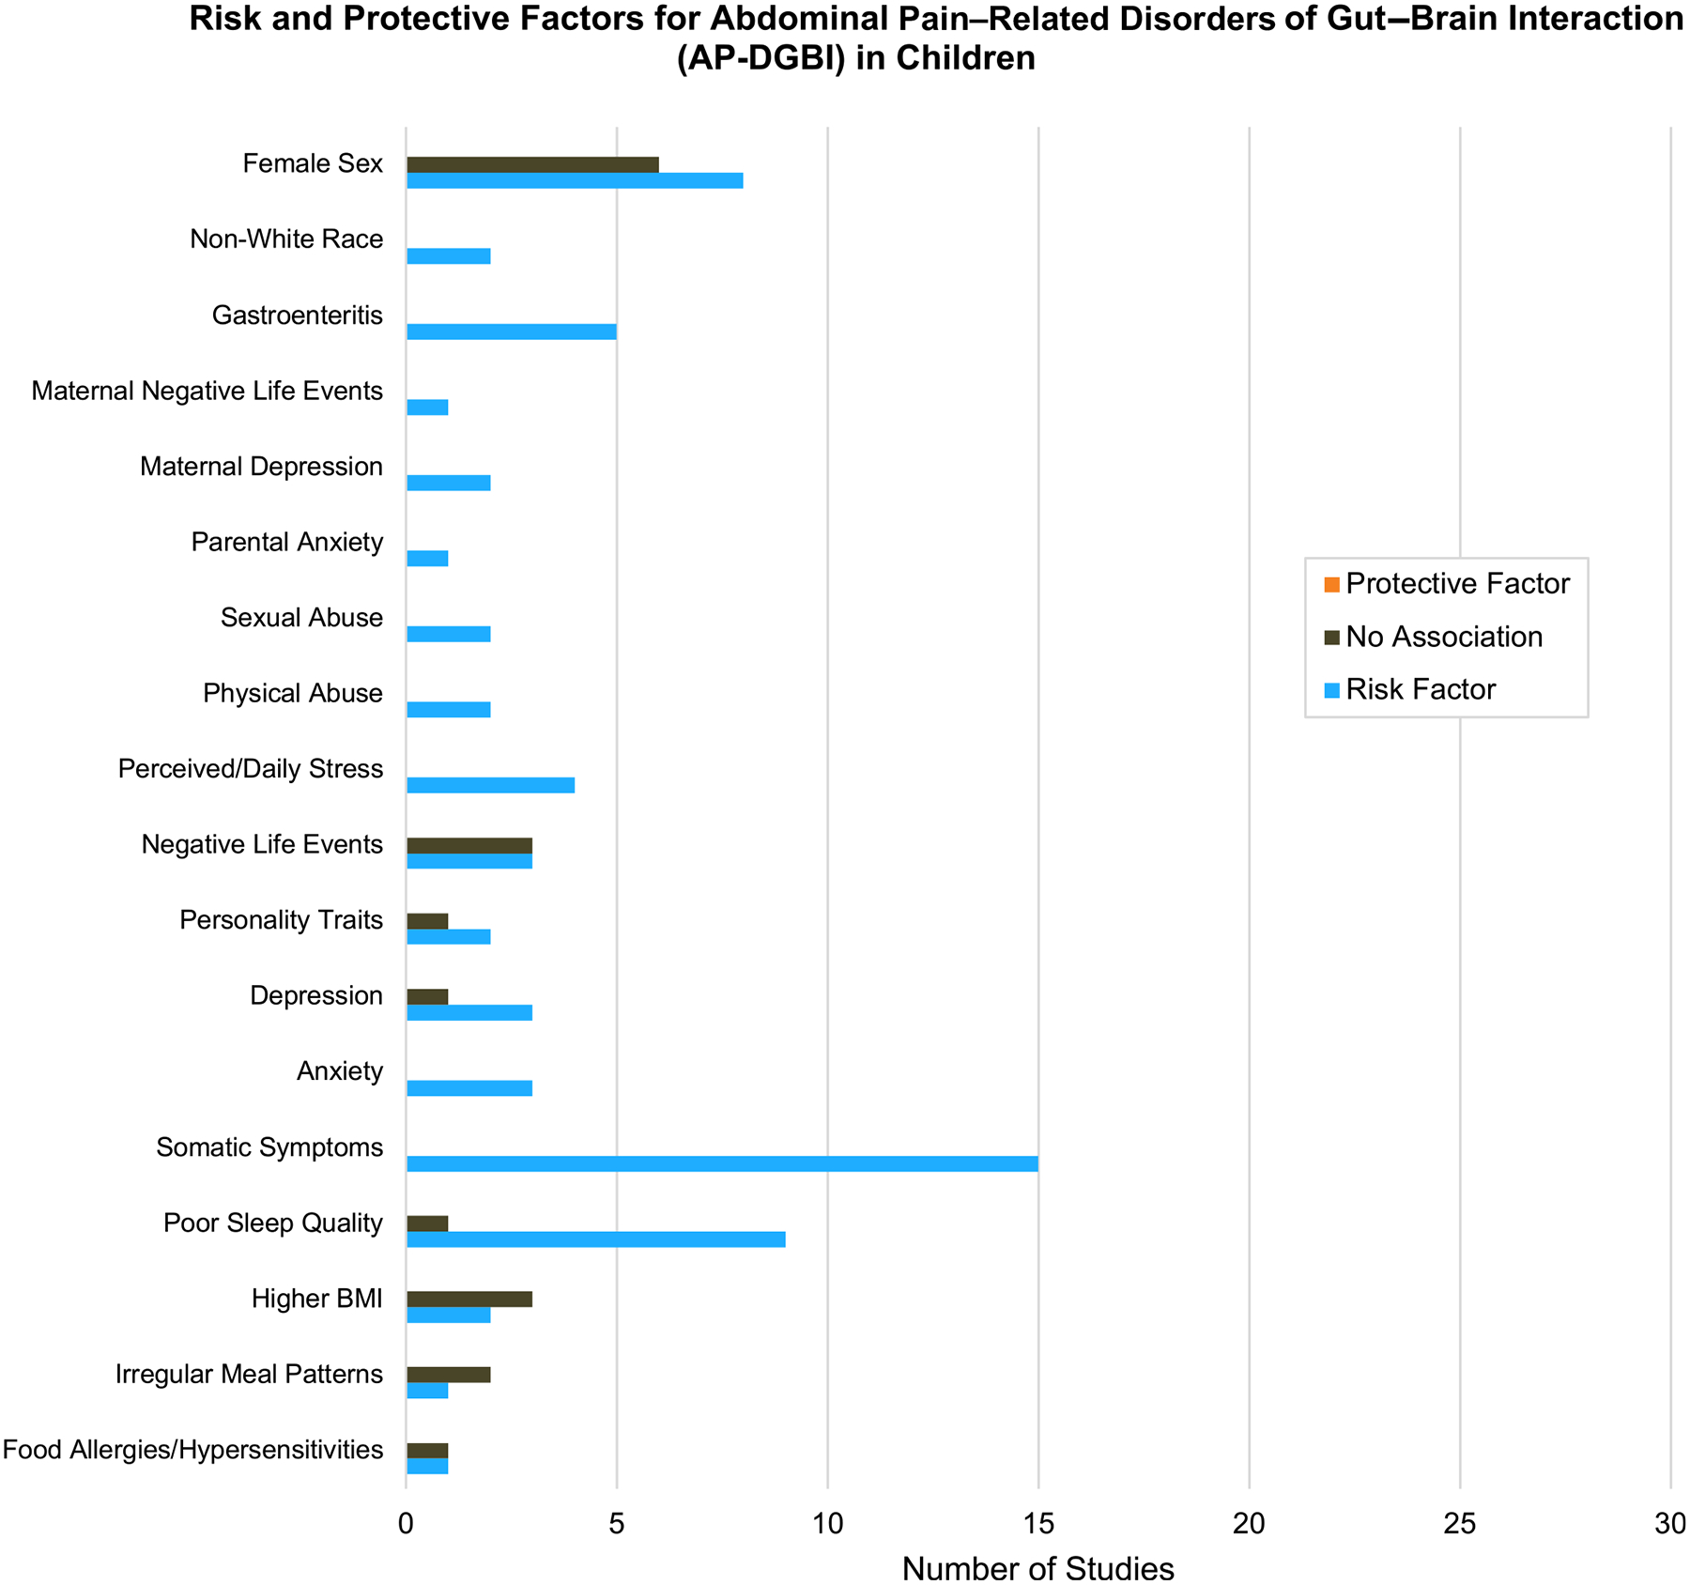
Overlap of behavioral health disorders and disorders of gut-brain interaction (DGBI).
Gastroenterology 2022 163(4): 995-1023

Slide 8
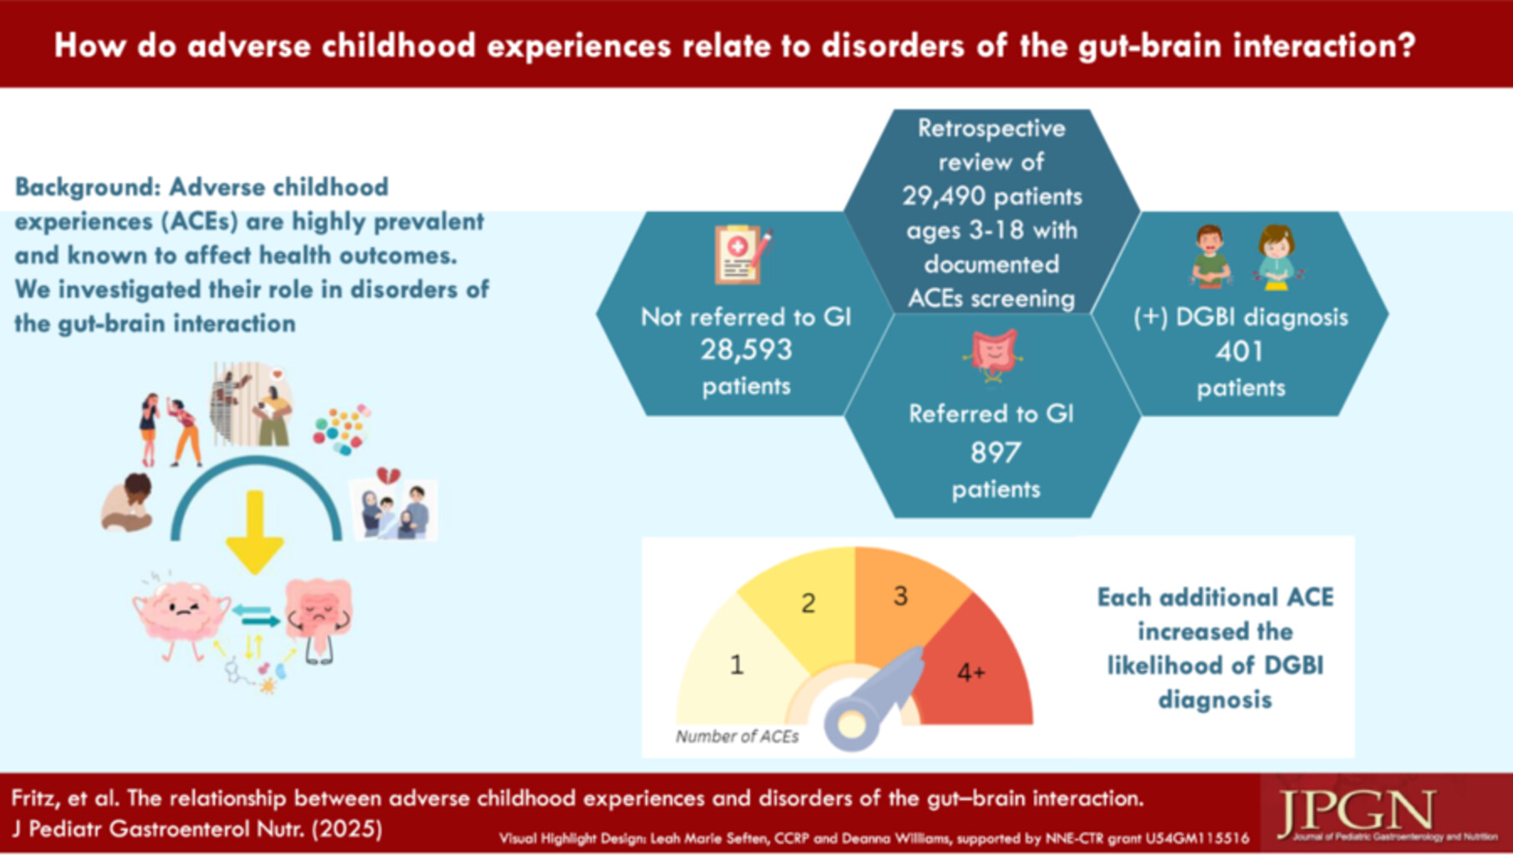
Overlap of behavioral health disorders and disorders of gut-brain interaction (DGBI).
JPGN 2025 80(1): 100-107

Slide 9
Early Conclusions
DGBI are common in children
Not enough gastroenterologists (or maybe even medical providers?) to diagnose and manage all
Behavioral Health Diagnoses and ACEs are associated with DGBI diagnoses
Any clinical interaction is an opportunity to recognizing, diagnose, educate about, and manage DGBI

Slide 10
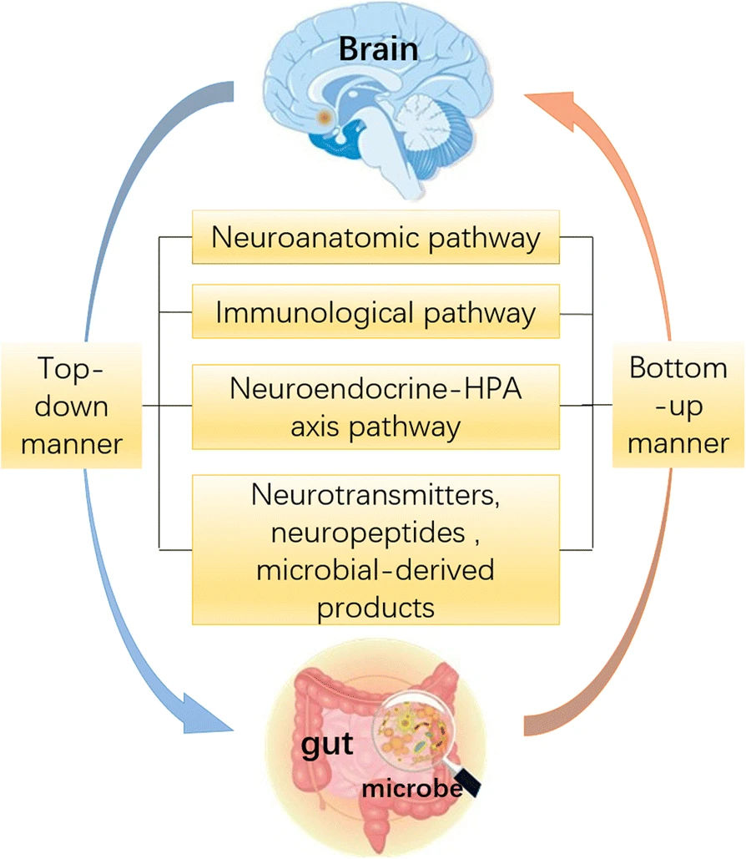
Pathophysiology
Behavioral Health Diagnoses and ACEs are associated with DGBI diagnoses
How?
Clinical Context

Slide 11
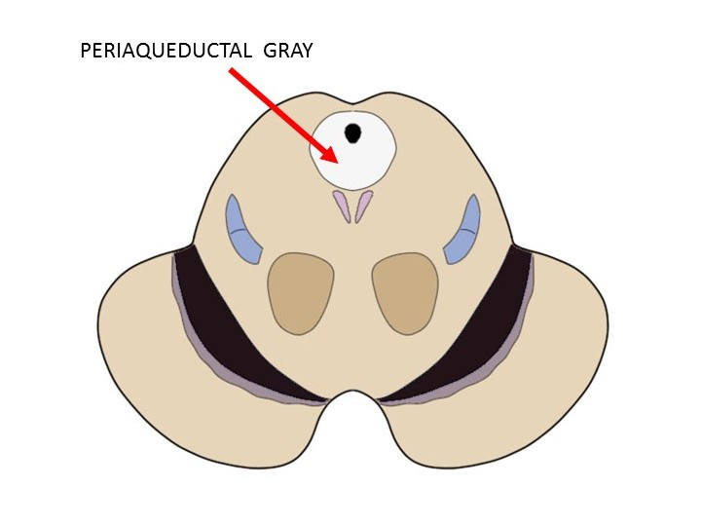

Pathophysiology: PAG mediates Chronic Pain
Area of the brain known to have an important role in pain processing
Differences in periaqueductal gray matter activity and/or connectivity have been associated with:
irritable bowel syndrome
primary dysmenorrhea
migraine
chronic low back pain
Neurogastroenterol Motil 2017;29:e13060

Slide 12
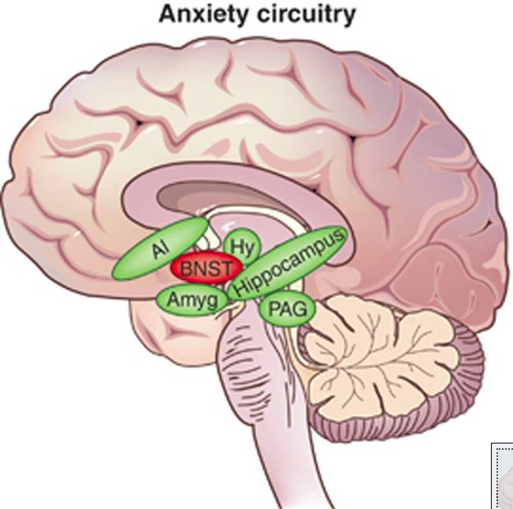
Pathophysiology: PAG/BNST relationship
PAG has significant functional connections to the bed nucleus of the stria terminalis (BNST)
BNST seems to have an important role in stress response and in anxiety and addiction
Neuropsychopharmacology REVIEWS 2016;41:126-141

Slide 13
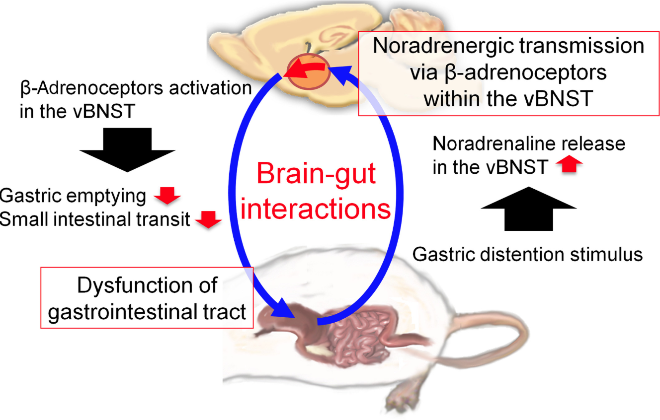
Pathophysiology: BNST/Gut Relationship
Neuropsychopharmacol Rep 2018;38(1):37-43

Slide 14


PAG/BNST/Gut Vicious Cycle
Pain/Anxiety/
Anticipation
Gastrointestinal
Dysfunction

Slide 15
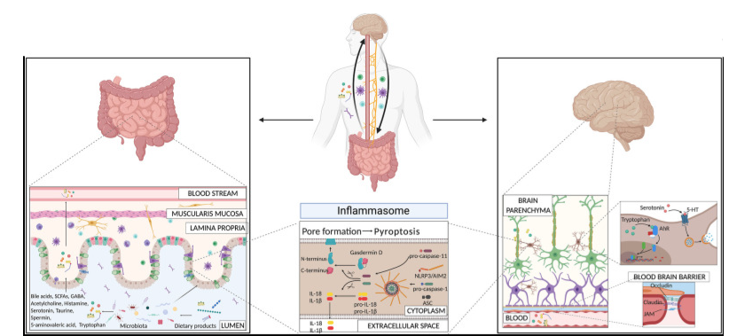
New Directions: Microbiota-Gut-Brain Axis
Two-way communication between the brain and gut microbiota:
microbial byproducts
immune and inflammatory pathway
neuroendocrine and enteroendocrine signaling
stress response and the vagus nerve
Front Immunol 2020 Dec 10:11:604179

Slide 16

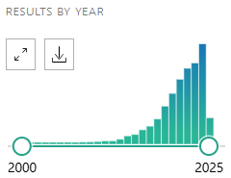
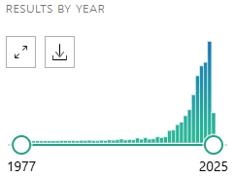
New Directions: Microbiota-Gut-Brain Axis
Microbiota gut brain axis
Disorder of Gut Brain Interaction
2202
665

Slide 17

Clinical Context: Anxiety
12 year prospective survey study.
1775 initially surveyed, 1002 completed follow-up (60%)
Higher baseline anxiety predicted development of FGID 12 years later
Baseline FGID predicted higher levels of anxiety and depression 12 years later
Clinical evidence of Brain-Gut connection bidirectionality
^{Gut 2012;61:1284-1290}

Slide 18

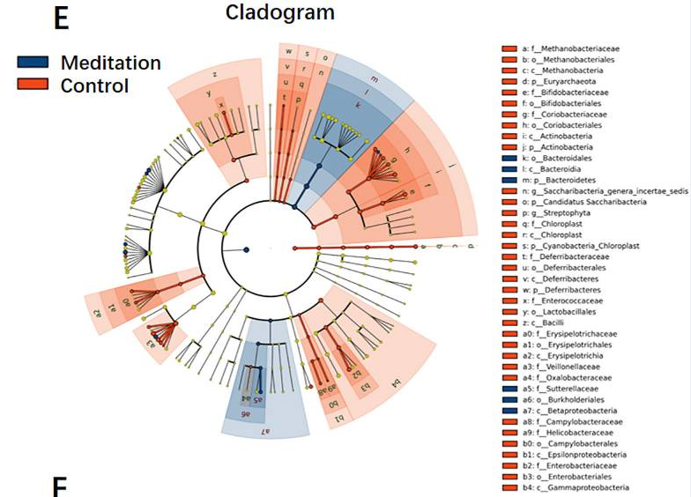
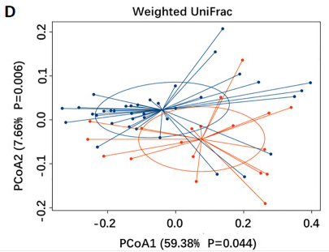
Clinical Context: Microbiome
Stool samples from 37 Buddhist monks (mediation) vs matched local residents (no meditation)
Clinical Evidence of connection between CNS and microbiome
Gen Psychiatr. 2023 Jan 3;36(1):e100893

Slide 19
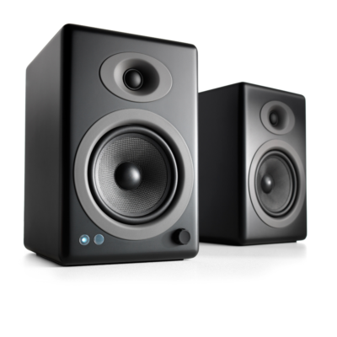
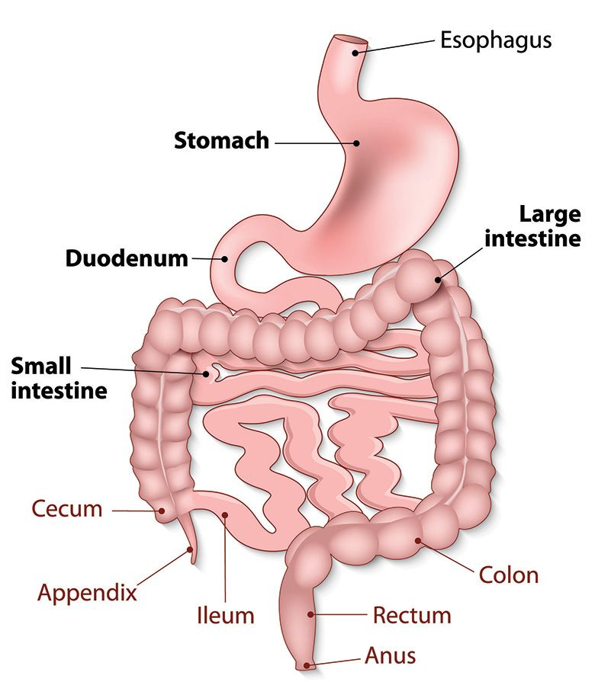
Neuroanatomy Pathophysiology Summary
“Because of nervous system physiology, life experiences, and microbiome variables, people with disorders of gut-brain interaction are wired to feel gastrointestinal signals more intensely than other people. They are often sensitive, driven, anxious or hypervigilent people because the wiring that makes them that way is the same wiring that drives abdominal pain.”

Slide 20
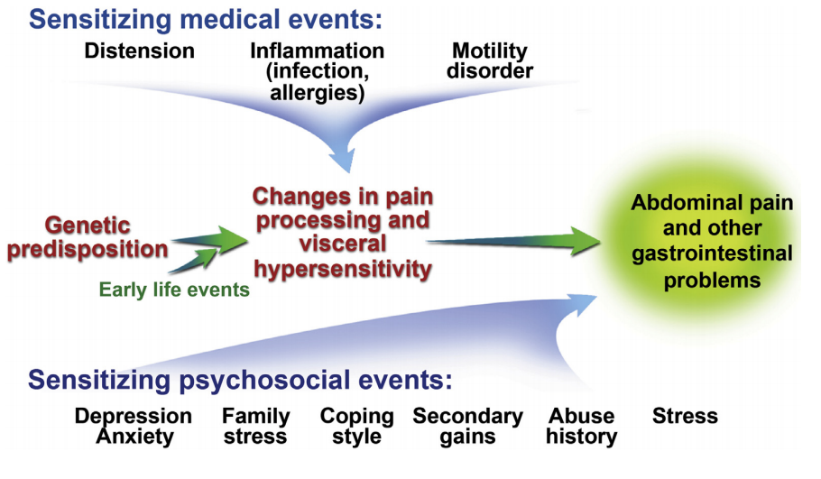







Pathophysiology Summary
Microbiota
Gastroenterology 2016; 150: 1456-1468

Slide 21
Pathophysiology Summary
“Because of nervous system physiology, life experiences, and microbiome variables, people with disorders of gut-brain interaction are wired to feel gastrointestinal signals more intensely than other people. They are often sensitive, driven, anxious or hypervigilent people because the wiring that makes them that way is the same wiring that drives abdominal pain.”
“We need to break the cycle of reactivity and turn down the sensitivity of the nervous system in order to help you feel better.”

Slide 22



Inspiration
“I don’t know if I’m elated or gassy but I’m somewhere in that zone.”
How can we make the diagnosis of Disorder of Gut-Brain Interaction?

Slide 23

Diagnosis Of DGBI
Step 1 – Know the patient and take a history, evaluate for alarm symptoms
Step(s) 2 – Exclude/Evaluate, Empathize, Educate
Step 3 – Positive Diagnosis Based on Rome Criteria

Slide 24
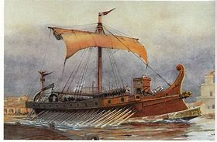

Rome Criteria
Symptom-based criteria by which child and adolescent functional gastrointestinal disorders (FGID) can be diagnosed
Combination of evidence and expert clinician consensus
2016: Rome IV
Rome V expected 2026, change to DGBI terminology
Gastroenterology 2016; 150: 1456-1468

Slide 25
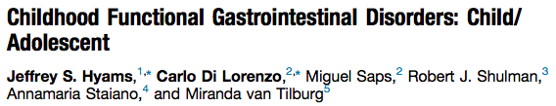
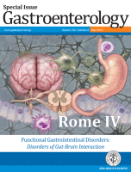
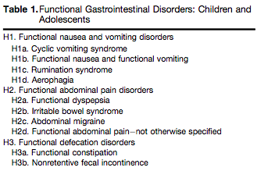

Rome Criteria
Gastroenterology 2016; 150: 1456-1468

Slide 26
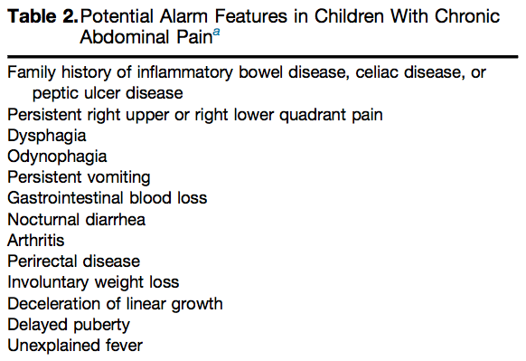

Take a History
Gastroenterology 2016; 150: 1456-1468
Notes:
Spend some time on this slide

Slide 27
Evaluate/Exclude
The most appropriate evaluation is the one that allows:
Provider to be satisfied with the diagnosis
Patient and family to be satisfied with the diagnosis
*Satisfied = Able to tolerate the remaining uncertainty and move forward with non-specific therapies to target symptoms of functional disorders rather than continuing to perseverate on/wonder “what’s wrong?”
Considerations include CBC, inflammatory markers, CMP, celiac
From there, considers testing to address specific symptoms/risks

Slide 28
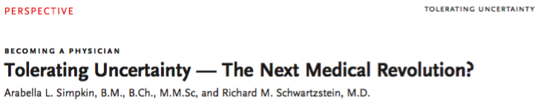
Empathize, Educate
“…it seems clear that technology will perform the routine tasks of medicine for which algorithms can be developed. Our value as physicians will lie in the gray-scale space, where we will have to support patients who are living with uncertainty — work that is essential to strong and meaningful doctor–patient relationships.”
NEJM 2016; 1: 1456-1468

Slide 29
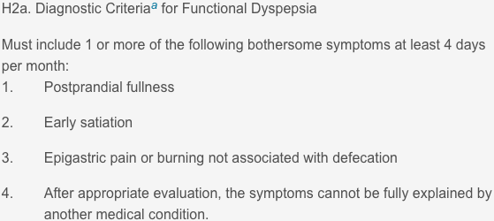
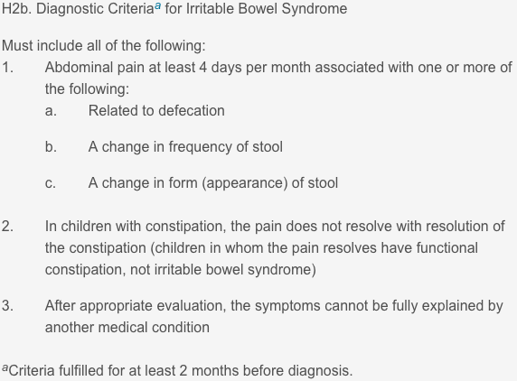
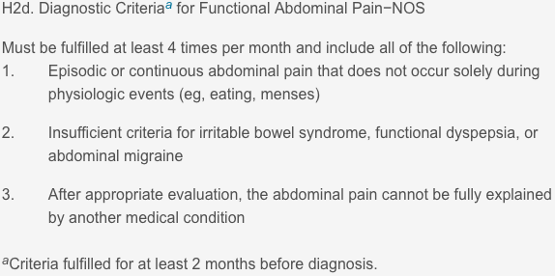
Then Diagnose in a Positive Fashion

Slide 30
Action Steps!
Understand patients and their symptoms thoroughly.
Discuss the differential diagnosis of symptoms and explain why you do or do not think they should be considered.
Introduce concept of DGBI and physiology to any patient with chronic GI symptoms.
Discuss turning down the sensitivity of the nervous system.
Educate patients and families confidently.
Suggest targeted tests you are comfortable with before referring.

Slide 31
Inspiration
“He who studies medicine without books sails an uncharted sea, but he who studies medicine without patients does not go to sea at all.”

Slide 32

Lifestyle measures
Function in School
Regulate Sleep Cycle
Avoid substances
Exercise Regularly

Slide 33
Non-Pharmacologic Therapy (Brain-Gut Behavioral Therapies)
Meditation/Mindfulness
Hypnotherapy
Cognitive Behavioral Therapy
Cochrane Database Syst Rev 2017 Review conclusion: “…data from trials to date provide some evidence for beneficial effects of CBT and hypnotherapy in reducing pain in the short term in children and adolescents presenting with RAP… there were insufficient data to explore effects of treatment by RAP subtype.”

Slide 34
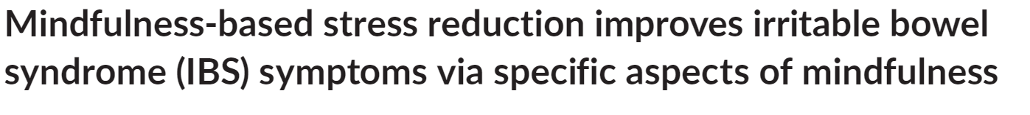
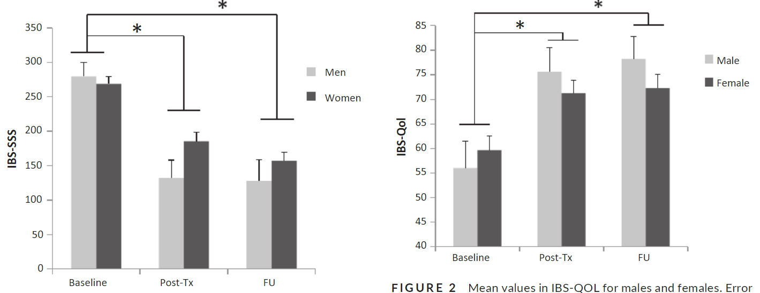
Meditation
Prospective Cohort: mindfulness program vs waitlist
Primary Outcome: IBS symptom scales
Clinically meaningful decrease in symptom severity
Neurogastro & Motility. 2020;32:e13828

Slide 35
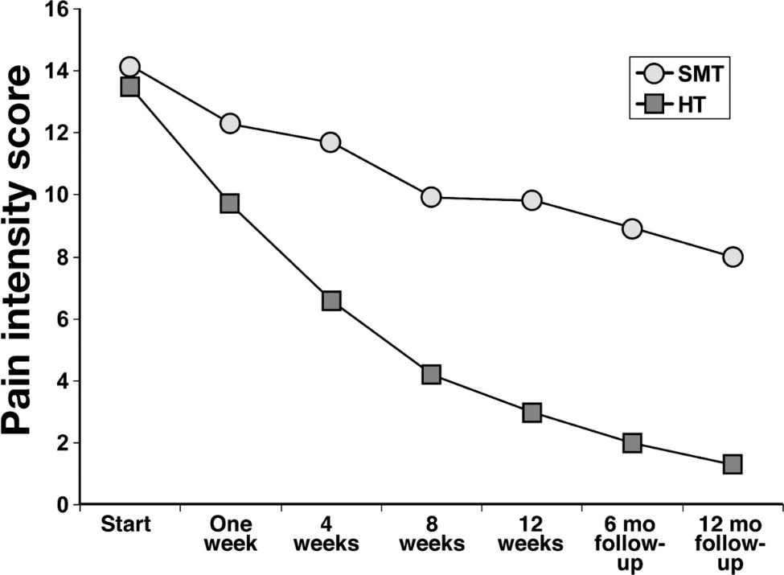
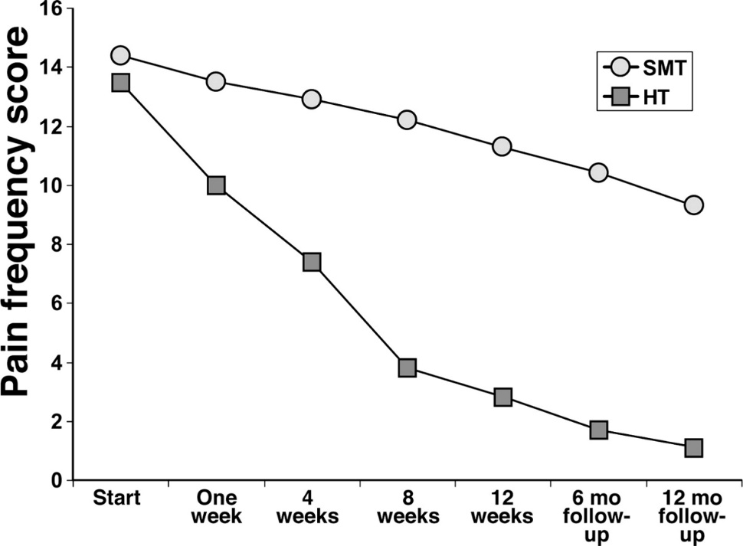
Hypnotherapy
RCT: Gut-directed hypnotherapy vs standard care
Outcomes: Pain intensity score, frequency score
Significant improvement in pain freq and intensity
Gastroenterology 2007;133:1430–1436

Slide 36

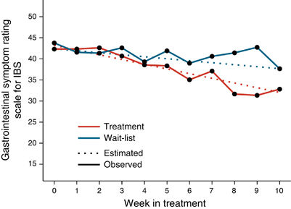
Cognitive Behavioral Therapy
RCT: iCBT vs waitlist control
Outcome: IBS symptom scale
Statistical Improvement in symptom scale over time in the treatment group
Am J Gastroenterol 2017;112:152-162

Slide 37
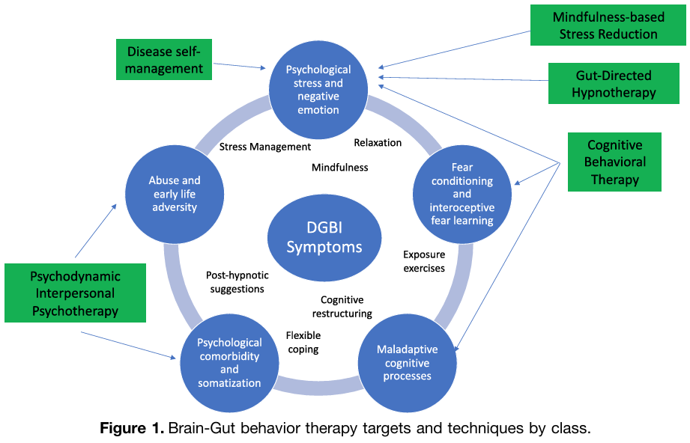
Non-Pharmacologic Therapy Summary
“BGBTs are clinician administered, short-term, non pharmacologic interventions that prioritize the remediation of GI symptoms over improvement of psychological co-morbidity, although the latter is also possible.”
Gastroenterology 2022;162:300-315

Slide 38
Pharmacologic Therapy
Cyproheptadine
Amitriptyline/TCA
Citalopram/SSRIs
Peppermint Oil
Cochrane Database Syst Rev 2017 Review conclusion: “…There is currently no convincing evidence to support the use of drugs to treat RAP in children. Well-conducted clinical trials are needed to evaluate any possible benefits and risks of pharmacologic interventions...”

Slide 39
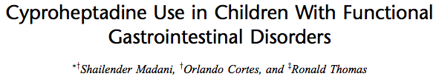
Cyproheptadine
Retrospective, Single Center, Single Clinician
Conclusion: cyproheptadine effective for improving symptoms of FGIDs
JPGN 2016;62:409-413

Slide 40
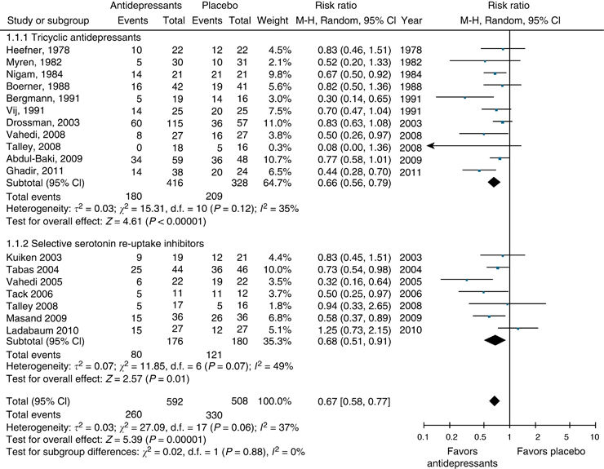
Antidepressants
TCA and SSRI are effective vs placebo in adults
Am J Gastroenterol 2014;109:1350–1365
Neurogastroenterol Motil 2014;26:1642–1650

Slide 41
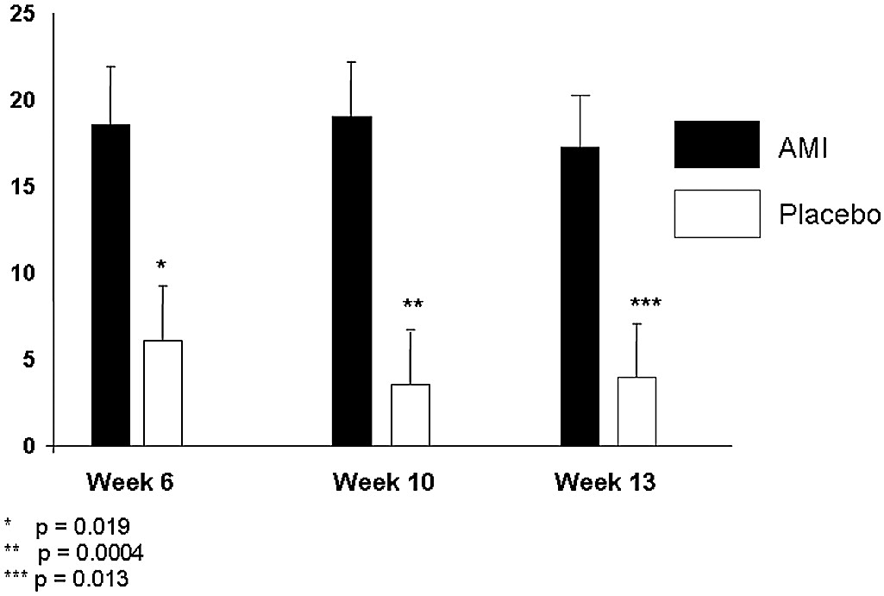
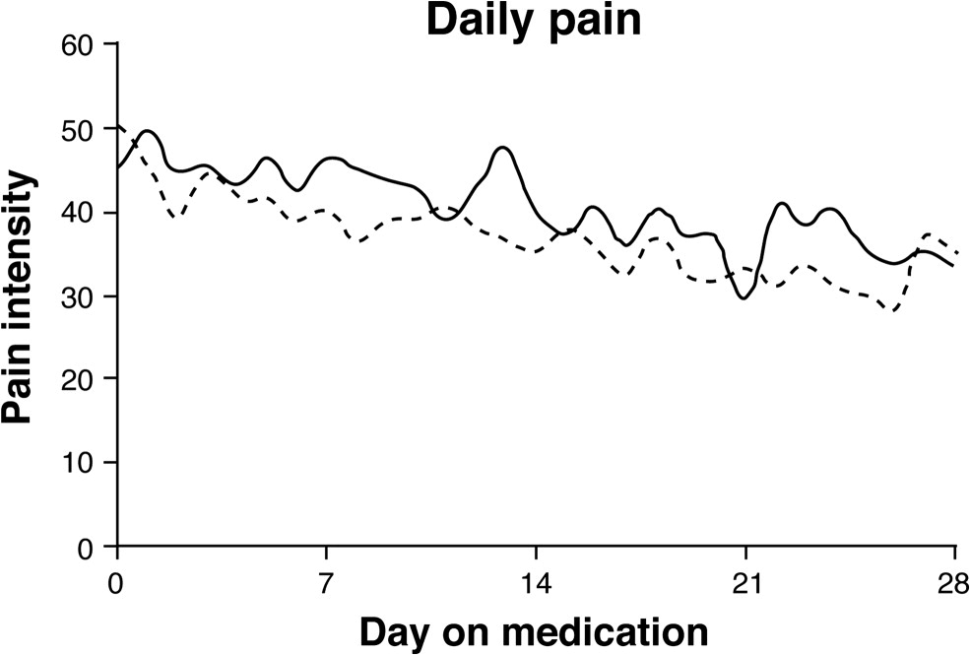
Amitriptyline
RCT: AMI vs Placebo
Primary Outcome: QoL
AMI > Placebo
J Pediatr 2008;152:685-9
RCT: AMI vs Placebo
Primary Outcome: Pain
Significant improvement in sx over time
No difference between AMI and placebo
Gastroenterology 2009;137:1261–1269

Slide 42
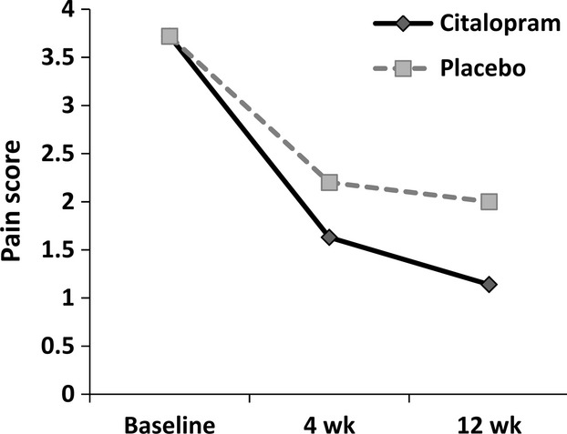
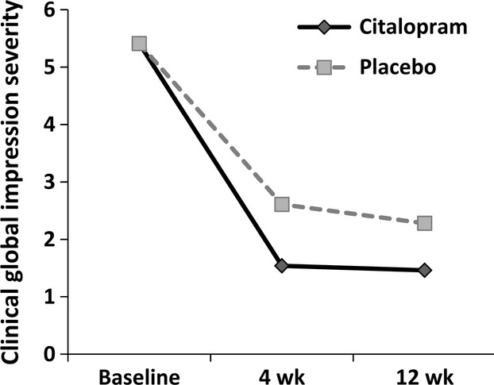
Citalopram
RCT: CIT vs Placebo
Primary Outcome: Pain
Difference not significant, both groups improved
Neurogastroenterol Motil 2014;26:1642–1650

Slide 43
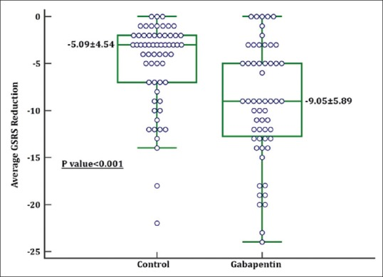
Gabapentin
Randomized Controlled Trial
omeprazole vs omeprazole plus gabapentin
Primary Outcome: Symptom Rating Scale
Symptom scale lower in the gabapentin group
Adv Biomed Res 2019;8:53

Slide 44
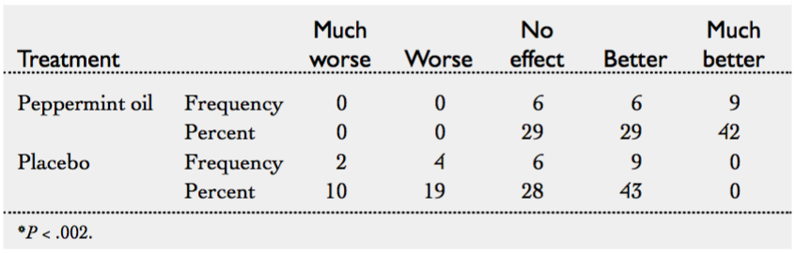
Peppermint Oil
RCT: Peppermint Oil vs Placebo
Primary Outcome: Pain
Significant Difference with improvement in peppermint oil group
J Pediatr 2001;138:125-128

Slide 45
Dietary Interventions
Low-FODMAP Diet
Probiotics
Cochrane Database Syst Rev 2017 Review conclusion: “…moderate to low quality evidence suggesting that probiotics may be effective in improving pain in children with RAP...there was no convincing evidence that fibre-based interventions improve pain in children with RAP...future trials of low FODMAP diets...are also required...”

Slide 46
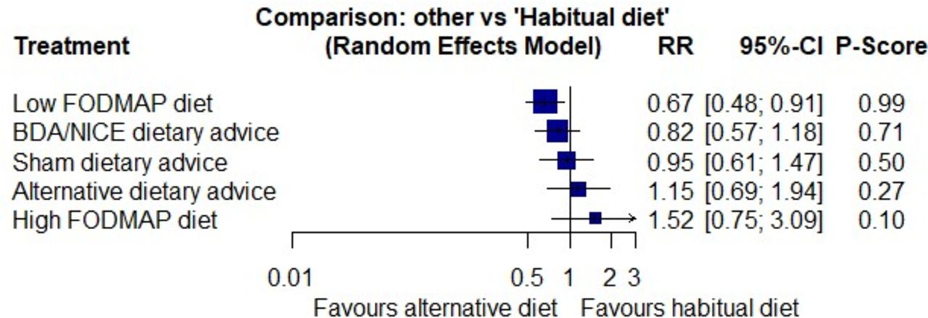
Low FODMAP Diet
Gut 2022; 71(6): 1117–1126

Slide 47
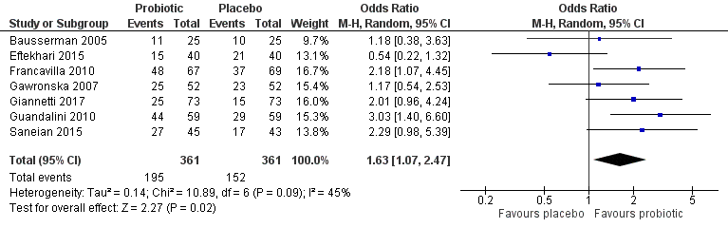
Probiotics
Multiple RCTs.
Multiple different strains/products used.
Favorable pooled analysis for IBS
Cochrane Database Syst Rev. 2017 Mar 23;3:CD010972

Slide 48
Weaknesses of the Literature
Few controlled trials
Small sample sizes
Not reproduced
Heterogeneous populations
All use Rome criteria
Some include all pain-predominant syndromes
Heterogeneous outcomes
Largely subjective
Few comparisons of interventions

Slide 49
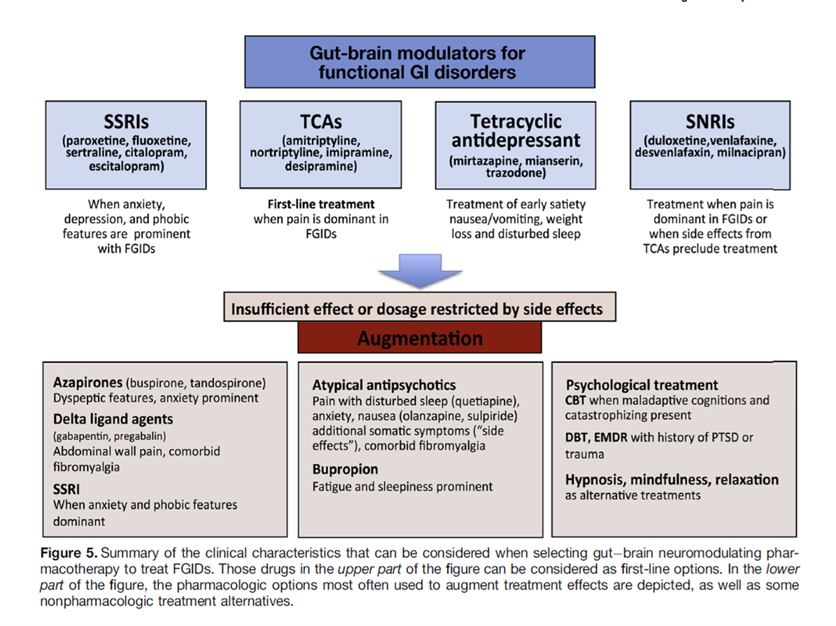
Pharmacotherapy Summary
Anti-spasmodic
Secretagogues
Cramping,
Diarrhea, gastro-
Colic reflex
Constipation
cyproheptadine

Slide 50
DGBI Therapy Summary
There are multiple safe non-pharmacologic, pharmacologic, and dietary interventions that can be considered to treat disorders of gut-brain interaction.
All have been studied in small scale and when applicable generally have relatively small effect compared to placebo.
Few to none have been studied on a large scale or reproduced.
And if you were paying attention to some of those graphs…

Slide 51
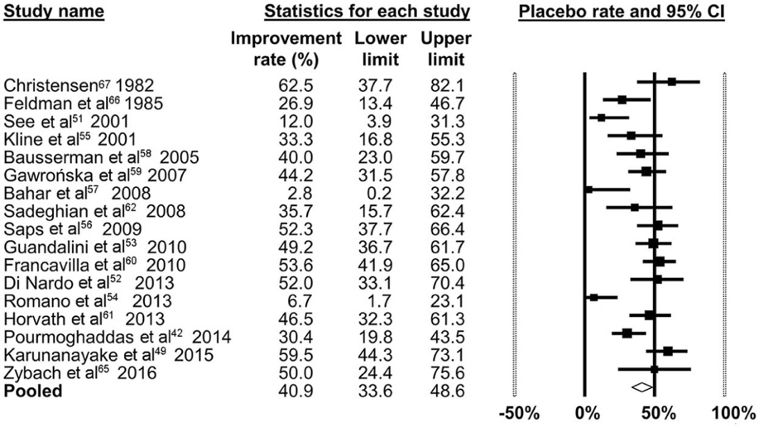
Placebo
41% of patients improve with placebo!
J Pediatr 2017;182:155-163

Slide 52
Placebo
“Placebo studies also reveal the value of social interaction as a treatment for pain...researchers studied patients in pain from irritable bowel syndrome and found that 44 percent of those given sham acupuncture had adequate relief from their symptoms.
If the person who performed the acupuncture was extra supportive and empathetic, however, that figure jumped to 62 percent.”
- NY Times, 1/9/2016

Slide 53
Action Steps!
Follow-up with patients after they are referred or after you start (or after we recommend) a therapy, monitor response to therapy.
Help students and families navigate school avoidance and encourage them to attend school.
Become familiar with and utilize resources:
Non-pharmacologic therapists in your offices/communities
Neuromodulating medications

Slide 54
Summary
Though our understanding of their physiology is incomplete, Disorders of Gut-Brain Interaction should be diagnosed in a positive fashion.
Objective evaluation should target tolerance of the uncertainty inherent in a DGBI diagnosis.
There is evidence to suggest that there are differences in neurological signaling (brain-gut interaction) between people with and without FGIDs.
There are many safe non-pharmacologic, pharmacologic, and dietary therapies that can be considered for treatment of FGIDs.
Ultimately our time, validation, and empathy may be just as important as any of them.

Slide 55

Thank you!
“Thank you all from the burning pit of my nauseous stomach”

