Slide 1
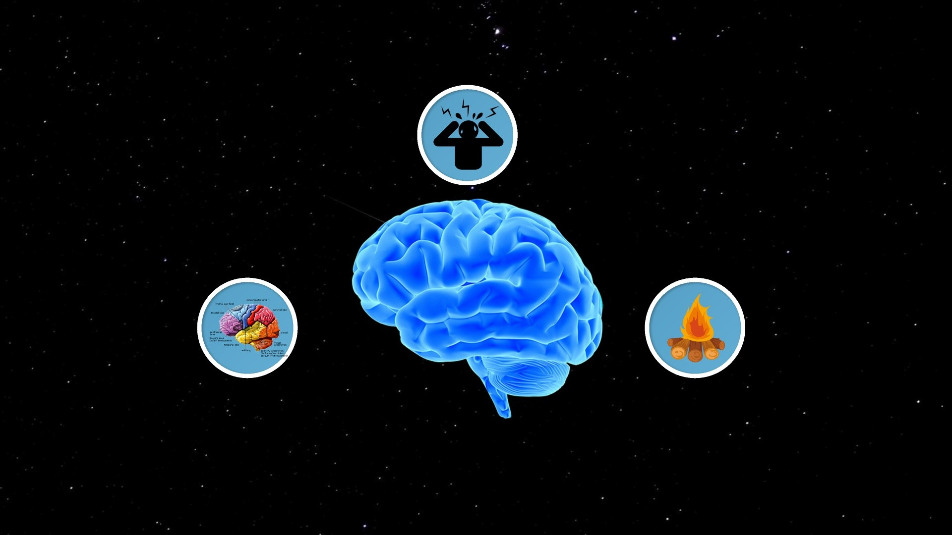

Presentation by:
Bear Shea LCSW 2020
w.bear.shea@maine.gov
Bear Shea LCSW
w.bear.shea@maine.gov

Slide 2
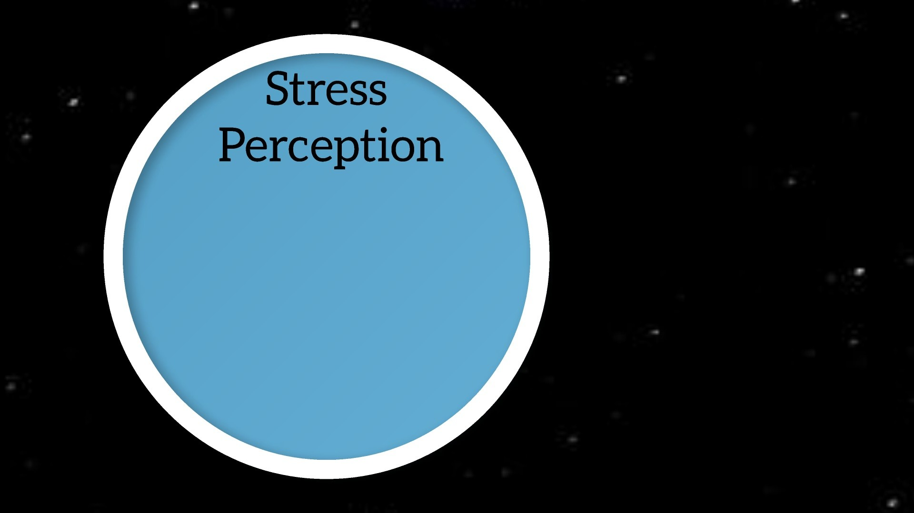
Anxiety
A sense (not feeling) of unease,
worry or dread
A sense (not feeling) of unease,
worry or dread
Can occur at varied levels of
intensity
Impacts physiologically,
emotionally, socially
A sense (not feeling) of unease,
worry or dread
Can occur at varied levels of
intensity
Impacts physiologically,
emotionally, socially
- Related to neurological sense
of stress and safety
A sense (not feeling) of unease,
worry or dread
Can occur at varied levels of
intensity
Notes:
We are now familiar with the way that the amygdala works and if we think about how experience can play into the sensitivity of the amygdala response and the near automatic shift from whole brain to survival brain it can cause us to look at stress in a different way.
What one amygdala may think about a picture may be different for others

Slide 3
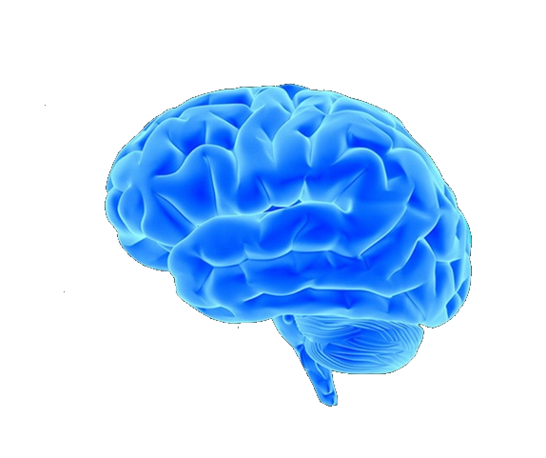
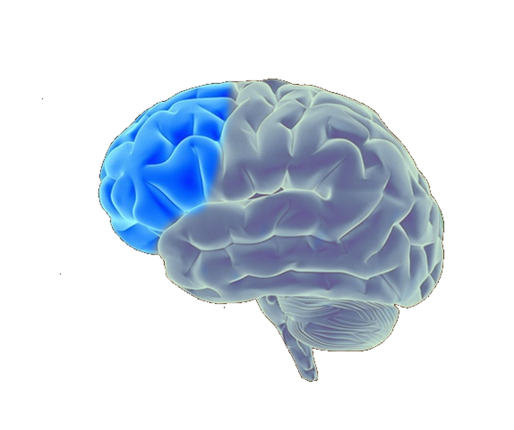
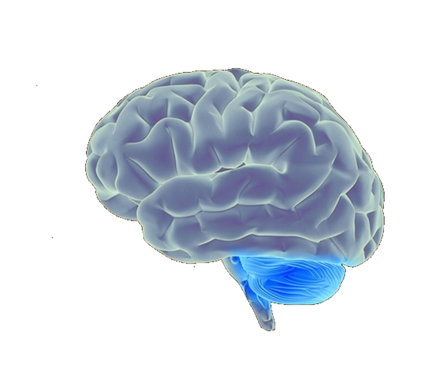

Notes:
We are now familiar with the way that the amygdala works and if we think about how experience can play into the sensitivity of the amygdala response and the near automatic shift from whole brain to survival brain it can cause us to look at stress in a different way.
What one amygdala may think about a picture may be different for others

Slide 4
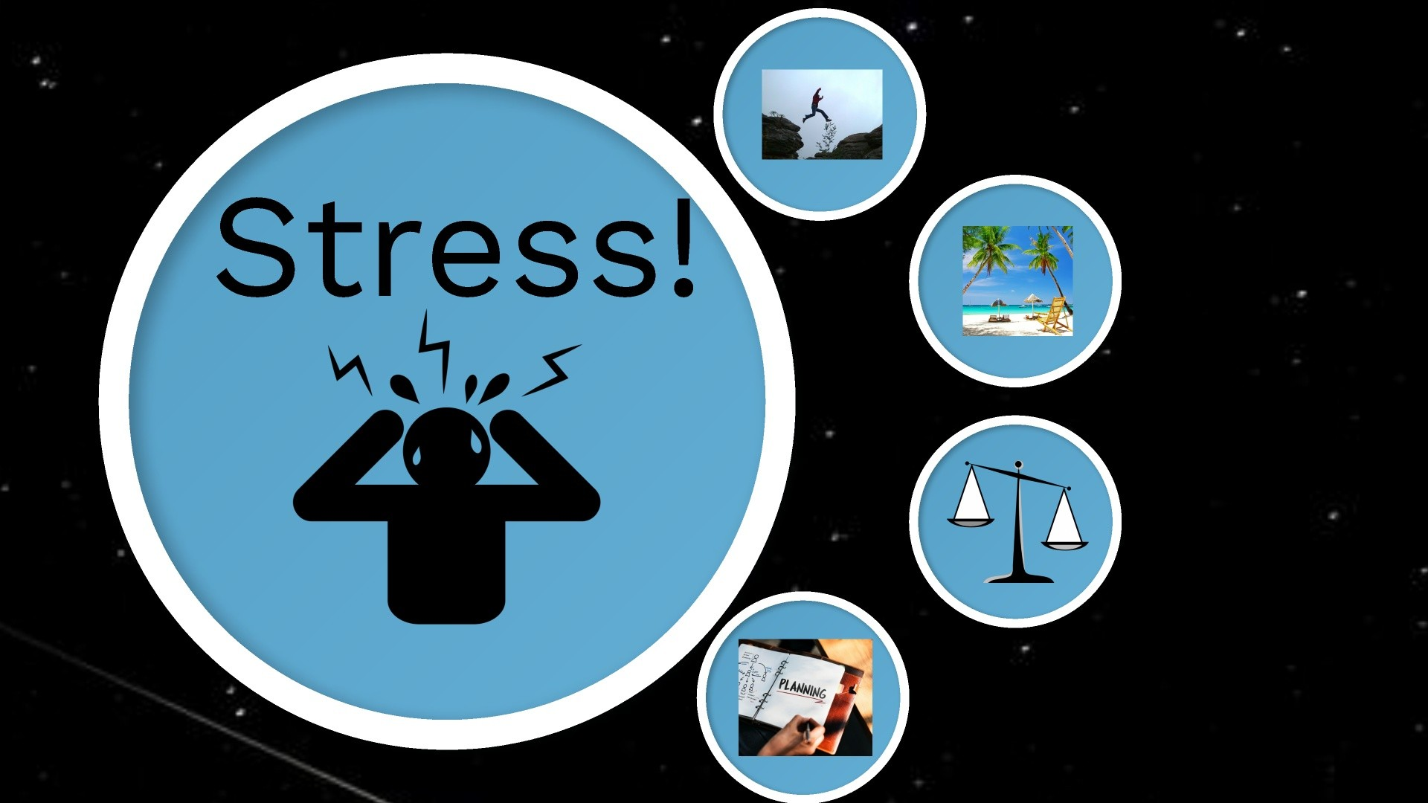
Notes:
This section is for stress… stress is something that we all experience and understanding it for everyone allows us to have a better understanding of how a brain that has experienced trauma might react.

Slide 5
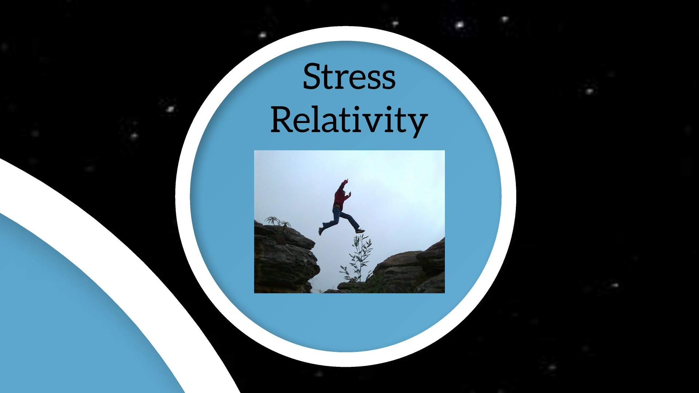
Notes:
While we may think we have an understanding that stress is relative we rarely give it much thought
- When we think about how brains wire and fire and are designed to create efficient responses, then we can begin to see how experience over time can change how we perceive stress and that things that are quite ordinary for some can be significant barriers for others

Slide 6
Notes:
We are now familiar with the way that the amygdala works and if we think about how experience can play into the sensitivity of the amygdala response and the near automatic shift from whole brain to survival brain it can cause us to look at stress in a different way.
What one amygdala may think about a picture may be different for others

Slide 7
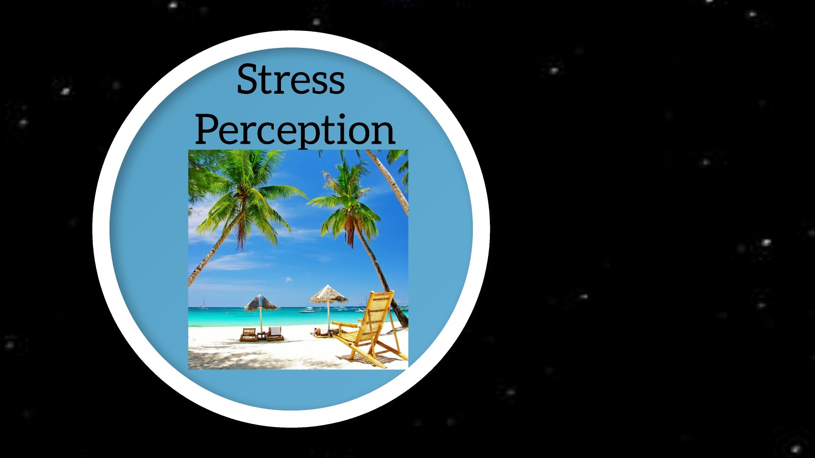
Notes:
I would bet many of us are seeing this image and thinking about relaxing vacation on the beach and umbrella drinks
- this is a good place to ham it up with how bad the weather is here etc. we want to lull them into a relaxed mood for the next slide
- “However, there are some amygdalas who see that same picture and instead of umbrella drinks…. They immediately think this (change to shark slide)

Slide 8
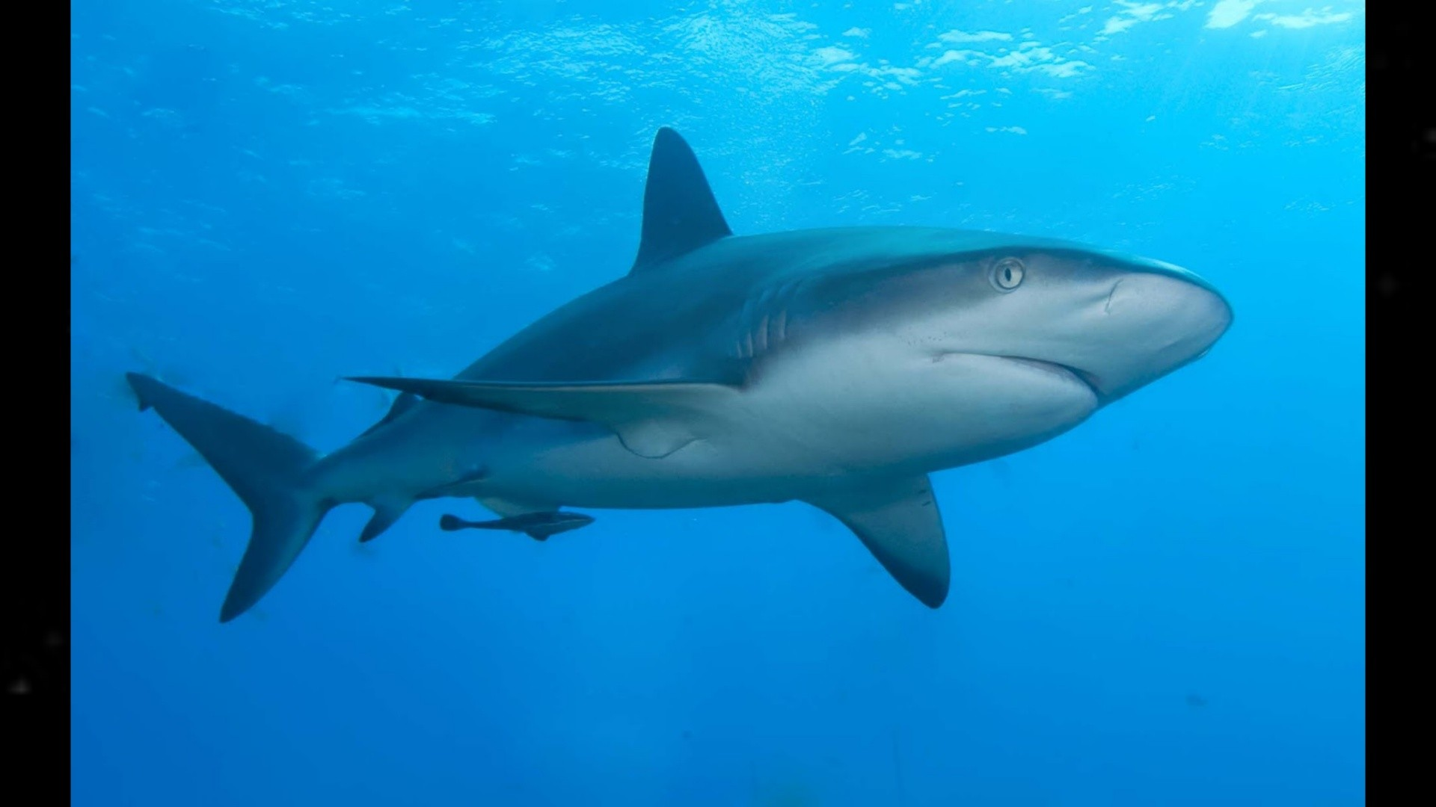
Notes:
This is the power of perception and how our amygdalas are trained by our experiences. This is for all of us and we can imagine that if someone has a history of traumatic experiences that their amygdala may have very different perceptions so that it can act to keep them alive

Slide 9
History of life experiences (amygdala response)
We are preloaded to perceive/feel unsafe
Generalized application
Seemingly irrational response
Notes:
We are now familiar with the way that the amygdala works and if we think about how experience can play into the sensitivity of the amygdala response and the near automatic shift from whole brain to survival brain it can cause us to look at stress in a different way.
What one amygdala may think about a picture may be different for others

Slide 10
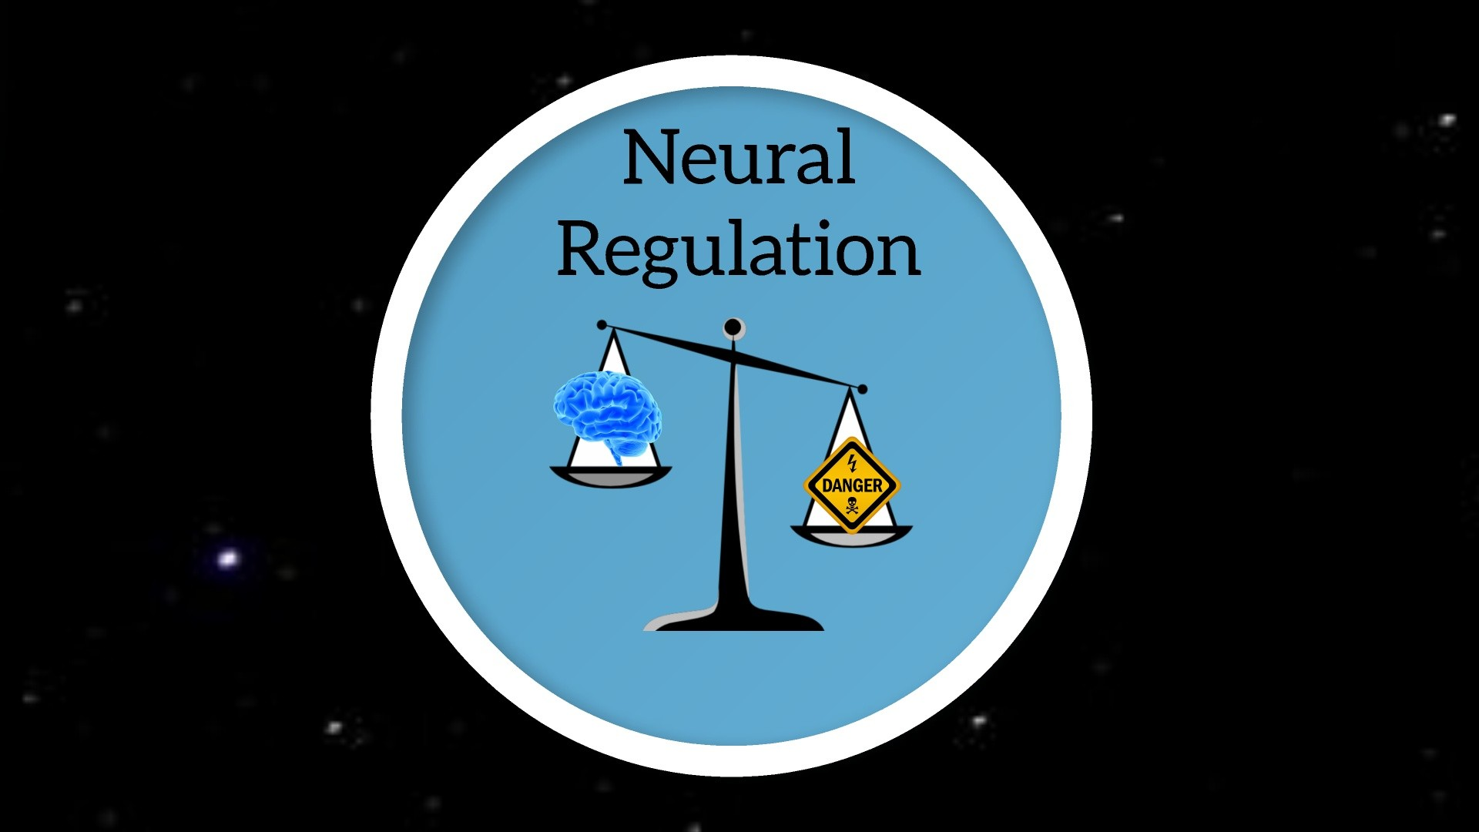

Slide 11
Neural Regulation
Regulation is not “Happy”
A regulated state is having your whole brain online and prepared to use all faculties to perceive, assess and choose the appropriate interaction.
Notes:
All of us are at our best, our most US when we are in neural regulation
This doesn’t mean “happy” or even content
It means our whole brain is online and able to take in the information
When we think about the window model with FF/FS the ideal is having our whole brain online
This means having our amygdala to warn, PFC to rationally assess and hind brain to react
We want to support each other and students to return to a regulated state where they have their PFC online before we work to process an event that caused dysregulation. Using relationship and safety can help go through a dysregulated event and help keep the PFC online so that it can be processed.
When the PFC is online it can assess that the dysregulation that happened was because of the survival response and that that response isn’t required… this is where change can begin to unwire some of the brains wired responses

Slide 12
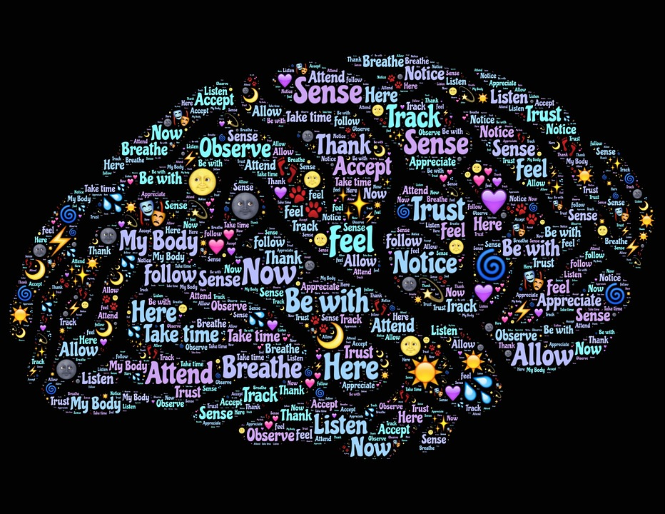
Anxiety Supports
Notes:
All of us are at our best, our most US when we are in neural regulation
This doesn’t mean “happy” or even content
It means our whole brain is online and able to take in the information
When we think about the window model with FF/FS the ideal is having our whole brain online
This means having our amygdala to warn, PFC to rationally assess and hind brain to react
We want to support each other and students to return to a regulated state where they have their PFC online before we work to process an event that caused dysregulation. Using relationship and safety can help go through a dysregulated event and help keep the PFC online so that it can be processed.
When the PFC is online it can assess that the dysregulation that happened was because of the survival response and that that response isn’t required… this is where change can begin to unwire some of the brains wired responses

Slide 13
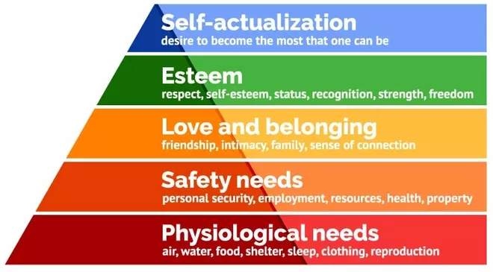
Maslow’s Hierarchy of Need

Slide 14
Support Strategies
Effects of Stress | Strategies to Help
Brain Chemistry | Encourage water, exercise, good nourishment. Create safe, welcoming socio-culturally trauma responsive environments. Develop opportunities to build relationships (mentor, connection at school or in neighborhood, community organizations).
Brain Development | Offer experiential activities. Take nothing for granted. Do direct teaching of procedures, behavioral expectations, problem-solving strategies. Practice deliberate, “Incidental Learning” – learning through proximity.
Brain Wiring / Encoding | Build positive cognitive and emotional connections! Model use of metaphor. Use graphic organizers to untangle multiple demands. Debrief everything, Give meaning to every lesson. Practice restorative disciplinary practices.
Notes:
All of us are at our best, our most US when we are in neural regulation
This doesn’t mean “happy” or even content
It means our whole brain is online and able to take in the information
When we think about the window model with FF/FS the ideal is having our whole brain online
This means having our amygdala to warn, PFC to rationally assess and hind brain to react
We want to support each other and students to return to a regulated state where they have their PFC online before we work to process an event that caused dysregulation. Using relationship and safety can help go through a dysregulated event and help keep the PFC online so that it can be processed.
When the PFC is online it can assess that the dysregulation that happened was because of the survival response and that that response isn’t required… this is where change can begin to unwire some of the brains wired responses

Slide 15
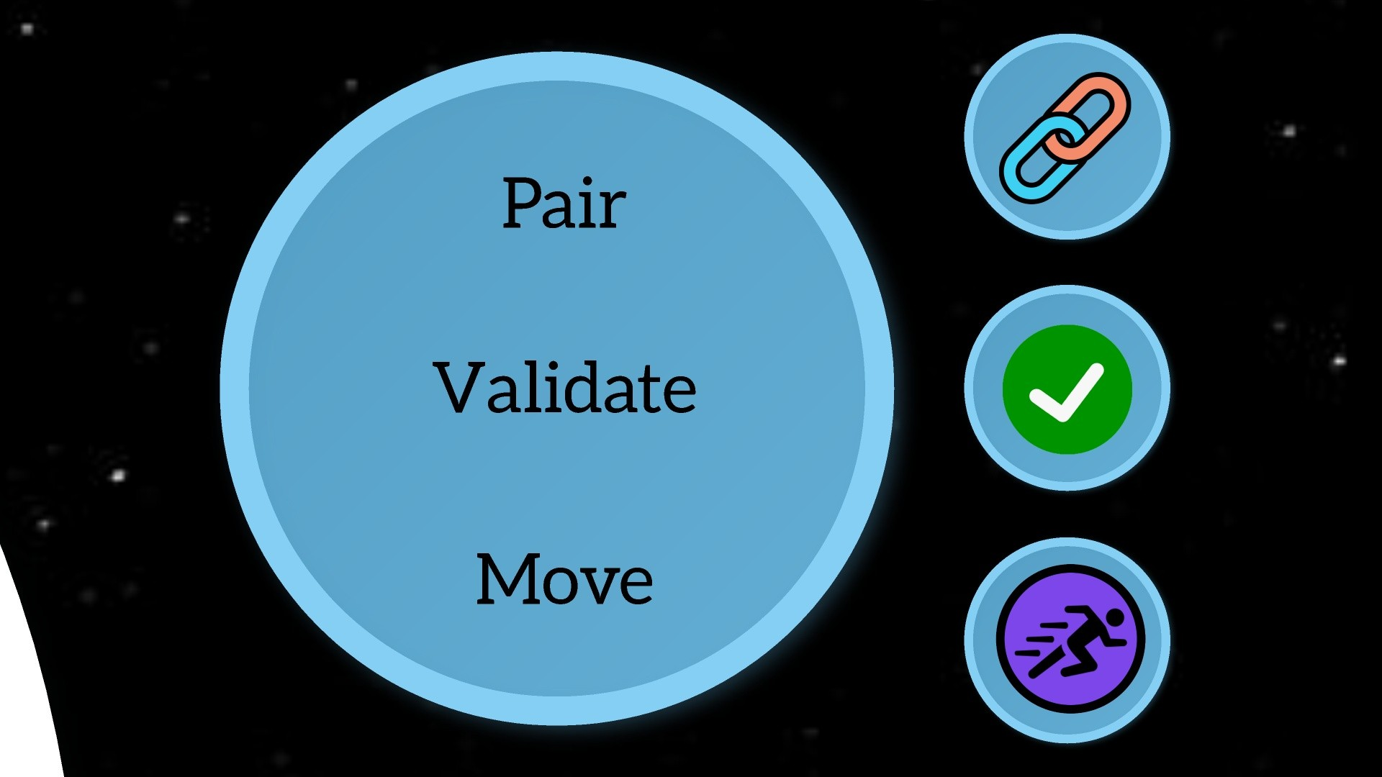

Slide 16
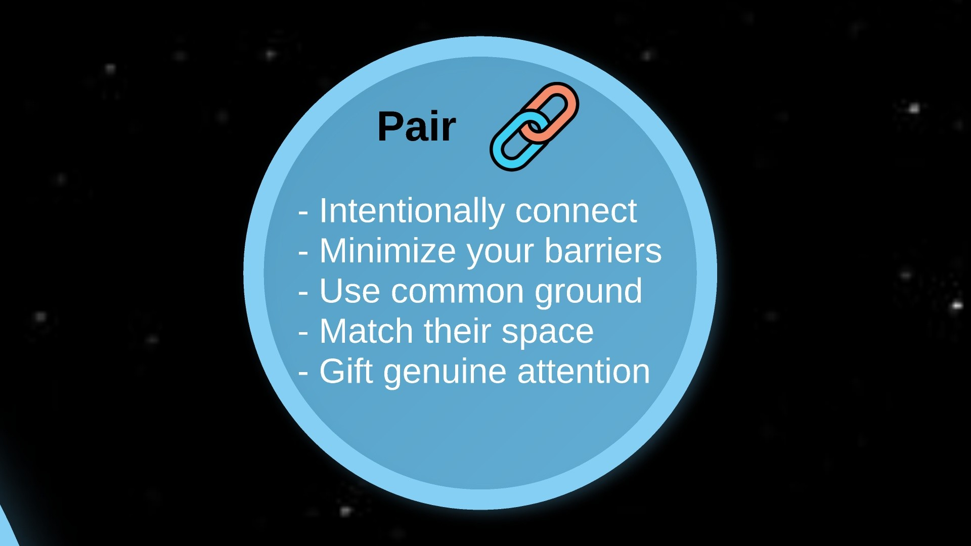

Slide 17
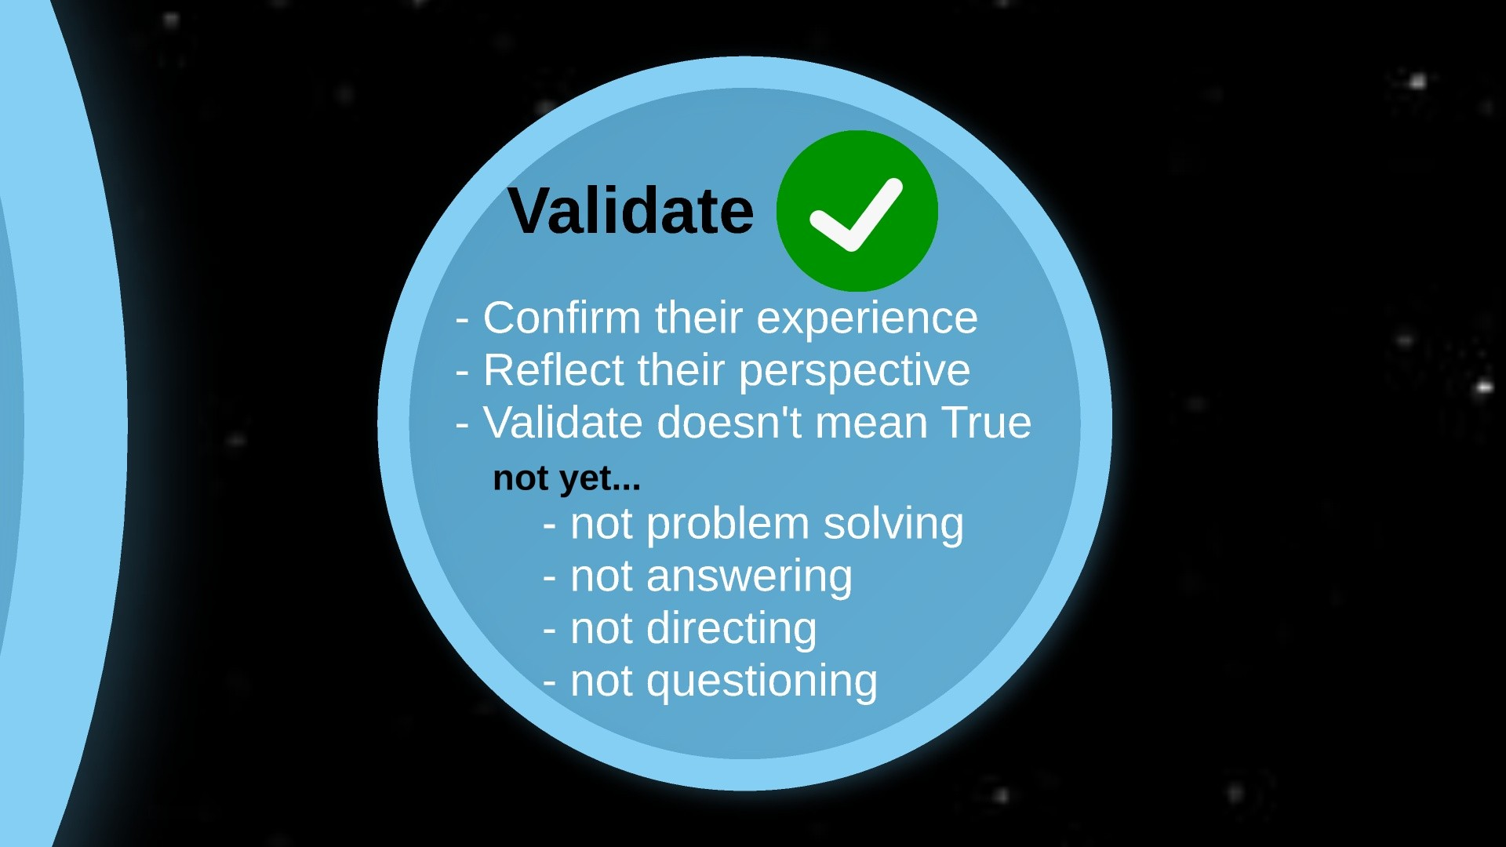

Slide 18
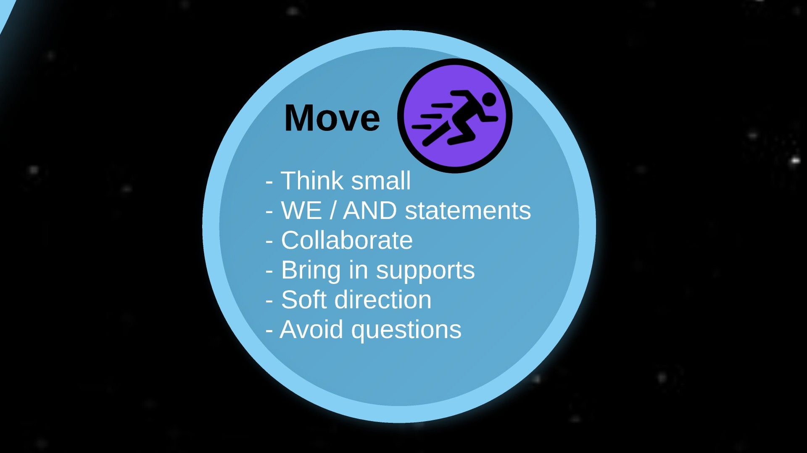

Slide 19
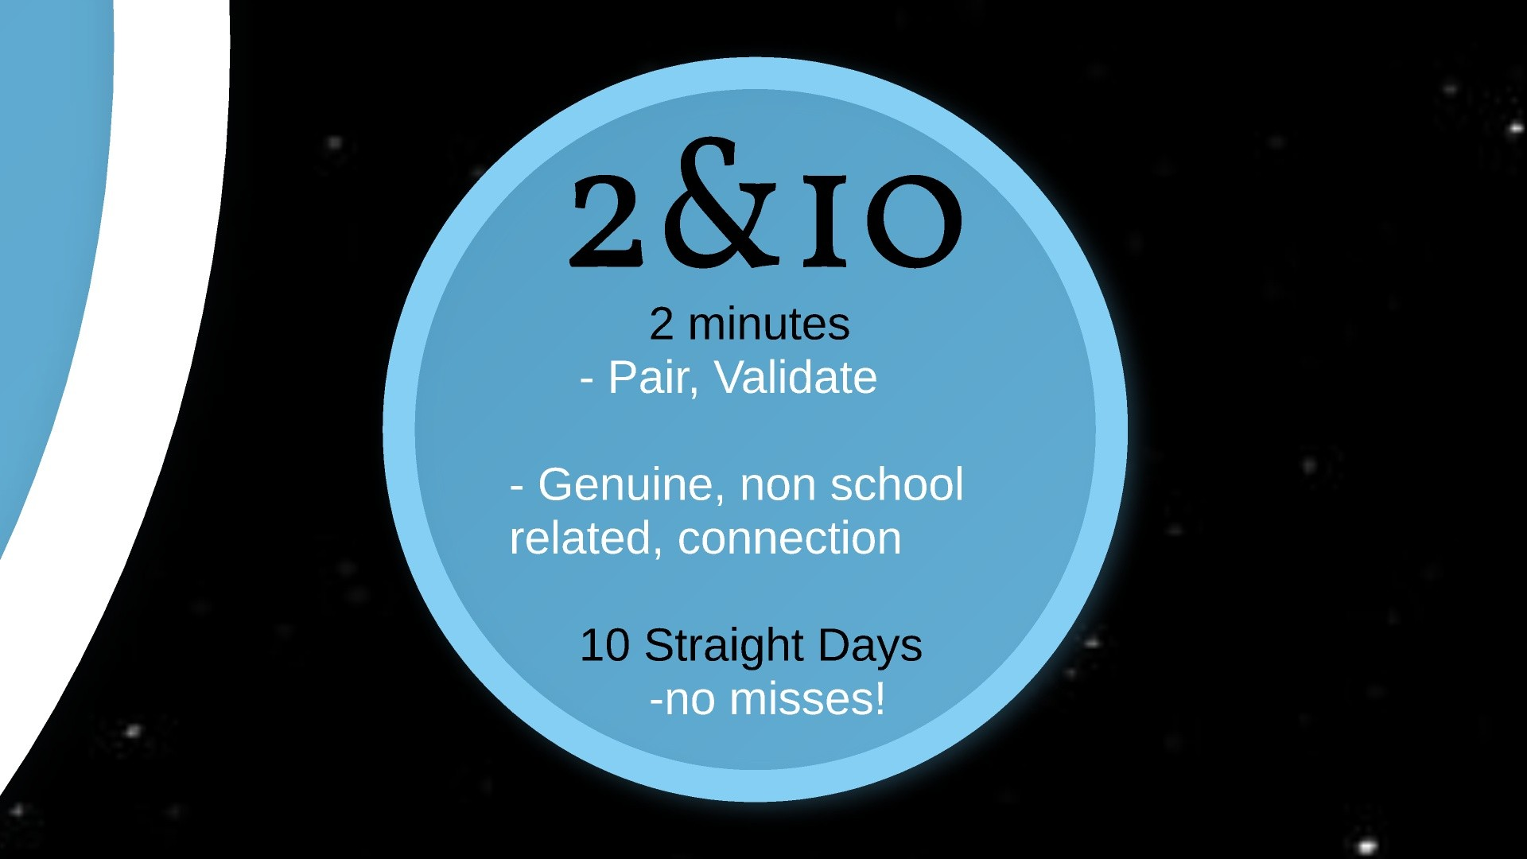

Slide 20
References
Myers DG, Diener E. (1996). The pursuit of happiness. Scientific American. 274(5):70–72.Lyubomirsky S, Sheldon KM, Schkade D. (2005). Pursuing happiness: the architecture of sustainable change. Review of General Psychology. 9(2):111–131.
Nettle D. (2005). Happiness: the science behind your smile. Oxford University Press.
DeNeve KM, Cooper H. (1998). The happy personality: a meta-analysis of 137 personality traits and subjective well-being. Psychological Bulletin. 124(2):197–229.
Magnus K et al. (1993). Extraversion and neuroticism as predictors of objective life events: a longitudinal analysis. Journal of Personality and Social Psychology. 65(5):1046–1053.
Tellegen A et al. (1988). Personality similarity in twins reared apart and together. Journal of Personality and Social Psychology. 54(6):1031–1039.
Saudino KJ, Plomin R. (1996). Personality and behavioral genetics: where have we been and where are we going? Journal of Research in Personality. 30:335–347.
Lykken D, Tellegen A. (1996). Happiness is a stochastic phenomenon. Psychological Science. 7(3):186–189.
Diener E et al. (1999). Subjective well-being: three decades of progress. Psychological Bulletin. 125(2):276–302.
Myers DG. (2000). The funds, friends, and faith of happy people. American Psychologist. 55(1):56–67.
Easterlin RA. (2003). Explaining happiness. PNAS. 100(19): 11176–11183.
Solnick SJ, Hemenway D. (1998). Is more always better? A survey on positional concerns. Journal of Economic Behavior & Organization. 37:373–383.
Easterlin RA. (1995). Will raising the incomes of all increase the happiness of all? Journal of Economic Behavior and Organization. 27:35–47.
Hafner K. (2006). In Web world, rich now envy the superrich. New York Times. November 21, 2006.
Easterlin RA. (2001). Income and happiness: towards a unified theory. Economic Journal. 111:465–484.
Suh E, Diener E, Fujita F. (1996). Events and subjective well-being: only recent events matter. Journal of Personality and Social Psychology. 70(5):1091–1102.

Slide 21
More References…
Diener E, Biswas-Diener R. (2002). Will money increase subjective well-being? Social Indicators Research. 57:119–169.
Diener E, Lucas RE, Scollon CN. (2006). Beyond the hedonic treadmill: revising the adaptation theory of well-being. American Psychologist. 61(4):305–314.
Butler AC et al. (2006). The empirical status of cognitive-behavioral therapy: a review of meta-analysis. Clinical Psychology Review. 26:17–31.
Sheldon KM, Lyubomirsky S. (2006). How to increase and sustain positive emotion: the effects of expressing gratitude and visualizing best possible selves. Journal of Positive Psychology. 1:73–82.
Burton CM, King LA. (2004). The health benefits of writing about intensely positive experiences. Journal of Research in Personality. 38:150–163.
Seligman MEP et al. (2005). Positive psychology progress. American Psychologist. 60(5):410–421.
Pennebaker JW. (1997). Writing about emotional experiences as a therapeutic process. Psychological Science. 8(3):162–166.
Emmons RA, McCullough ME. (2003). Counting blessings versus burdens: an experimental investigation of gratitude and subjective well-being in daily life. Journal of Personality and Social Psychology. 84(2):377–389.
Sheldon KM, Lyubomirsky S. (2006). Achieving sustainable gains in happiness: change your actions, not your circumstances. Journal of Happiness Studies. 7:55–86.
Sheldon KM, Lyubomirsky S. (2004). Achieving sustainable new happiness: prospects, practices, and prescriptions. In A. Linley & S. Joseph. Eds. Positive psychology in practice. pp. 127–145. John Wiley & Sons.
Karremans JC et al. (2003). When forgiving enhances psychological well-being: the role of interpersonal commitment. Journal of Personality and Social Psychology. 84(5):1011–1026.
Taylor JB. (2006). My stroke of insight: a brain scientist’s personal journey. Viking.
Kaufman L. (2008). A superhighway to bliss. New York Times. May 25, 2008.
Wachholtz AB, Pargament KI. (2005). Is spirituality a critical ingredient of meditation? Comparing the effects of spiritual meditation, secular meditation, and relaxation on spiritual, psychological, cardiac, and pain outcomes. Journal of Behavioral Medicine. 28(4):369–84.
Davidson RJ et al. (2003). Alterations in brain and immune function produced by mindfulness meditation. Psychosomatic Medicine. 65:564–570.

Slide 22
Acknowledgements:
Hand/Brain Model: Dan Seigel
Mindsight : The New Science of Personal Transformation. New York: Bantam Books, 2010.
Window of Tolerance (Base): Pat Ogden
Ogden, P., Minton, K., and Pain, C. (2006). Trauma and the body: A sensorimotor approach to psychotherapy. New York: Norton
Window of Tolerance (Advanced): Deb Dana LCSW, Tracy Morton Stanford LCSW, Phil Devoe LCSW
Island Institute for Trauma Recovery http://iitrme.com/
Collaborators:
Susan Burns-Chong LCSW

Slide 23
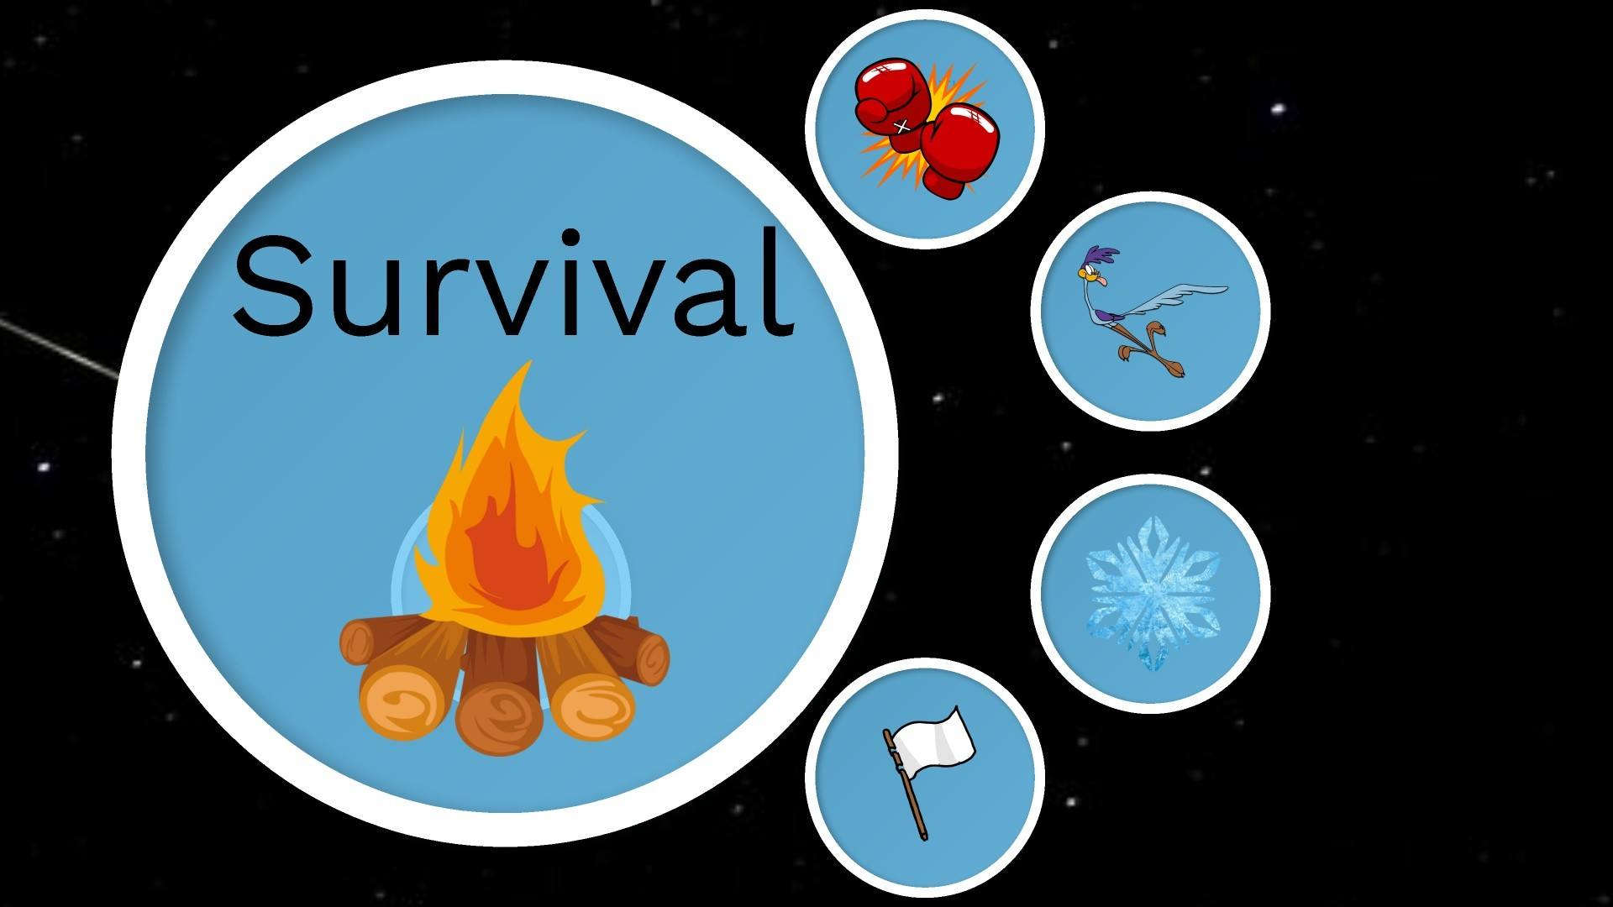
Notes:
When our amygdala goes off and our prefrontal cortex begins to go dark, our survival brain kicks in to keep us alive
There are four types of survival skills that ALL animals use. (don’t reveal those yet)

Slide 24
Fight and Flight
Response to Interventions:
Increase in dysregulation to any perceived power
Reduced ability to engage in cognitive discussions
Black or white thinking
Focused on immediate threat and not long term consequences
Doing anything to get out of conversation
Psychomotor agitation often perceived as disrespectful
Shift to FREEZE or SUBMIT
What it Looks Like:
Physical or Verbal Aggression
Stomping, pacing
Breaking/Striking Objects
Incoherent rants
Running away from situation
Leaving home/school
Poor decision making
Saying things that are extreme and harmful to others
Suicidal thoughts
Self harm
Response to Support:
Deny that there is any need for support
Actively avoid positive peers or mentors
Increase in reactive behavior
Shift to FREEZE or SUBMIT
Notes:
This is a simple way of seeing how fight/flight looks and then ways that a dysregulated brain could respond to interventions and even supports until it regulates which is why any intervention that relies on questions or talk
Could increase dysregulation or cause the person to change to a different survival method

Slide 25
Freeze and Submit
What it Looks Like:
Non responsive
Yes/No answers only
Agreeing to anything said
Self deprecation
Isolation from supports
Chronically late or absent
Excessive sleeping
Self harm
Suicidal thoughts
Response to Interventions:
Increase dysregulation to any perceived power
Emotionally flat
Agreeing to all that is said
Not engaged
May fall asleep
Black or white thinking
Perceived as not caring and disrespectful
Shift to FIGHT or FLIGHT
Response to Support:
May be present but not engage
Agreeing to all that is said
Missing support meetings
Unable to remember past interventions
Increase in avoidant behavior
Emotionally flat or unavailable
Shift to FIGHT or FLIGHT
Notes:
This is a simple way of seeing how freeze/submit looks and then ways that a dysregulated brain could respond to interventions and even supports until it regulates which is why any intervention that relies on questions or talk
Could increase dysregulation or cause the person to change to a different survival method
- You can compare how similar the responses are even though fight/flight seem so different

